Slide 1

Associationistist Theories
Dinda Permatasari Harahap
Faculty of Psychology
Universitas Medan Area
dinda@staff.uma.ac.id

Slide 2
What’s Associationism?
Associationism is a theory that connects learning to thought based on principles of the organism’s causal history.

Slide 3
What’s Associationism?
Associationism can be used as a theory of learning (e.g., as in behaviorist theorizing), a theory of thinking (as in Jamesian “streams of thought”), a theory of mental structures (e.g., as concept pairs), and a theory of the implementation of thought (e.g., connectionism).

Slide 4
Associationism as a Theory of Learning

Slide 5
Pavlov introduced the concept of classical conditioning as a modernized version of associative learning.
Ivan Pavlov

Slide 6
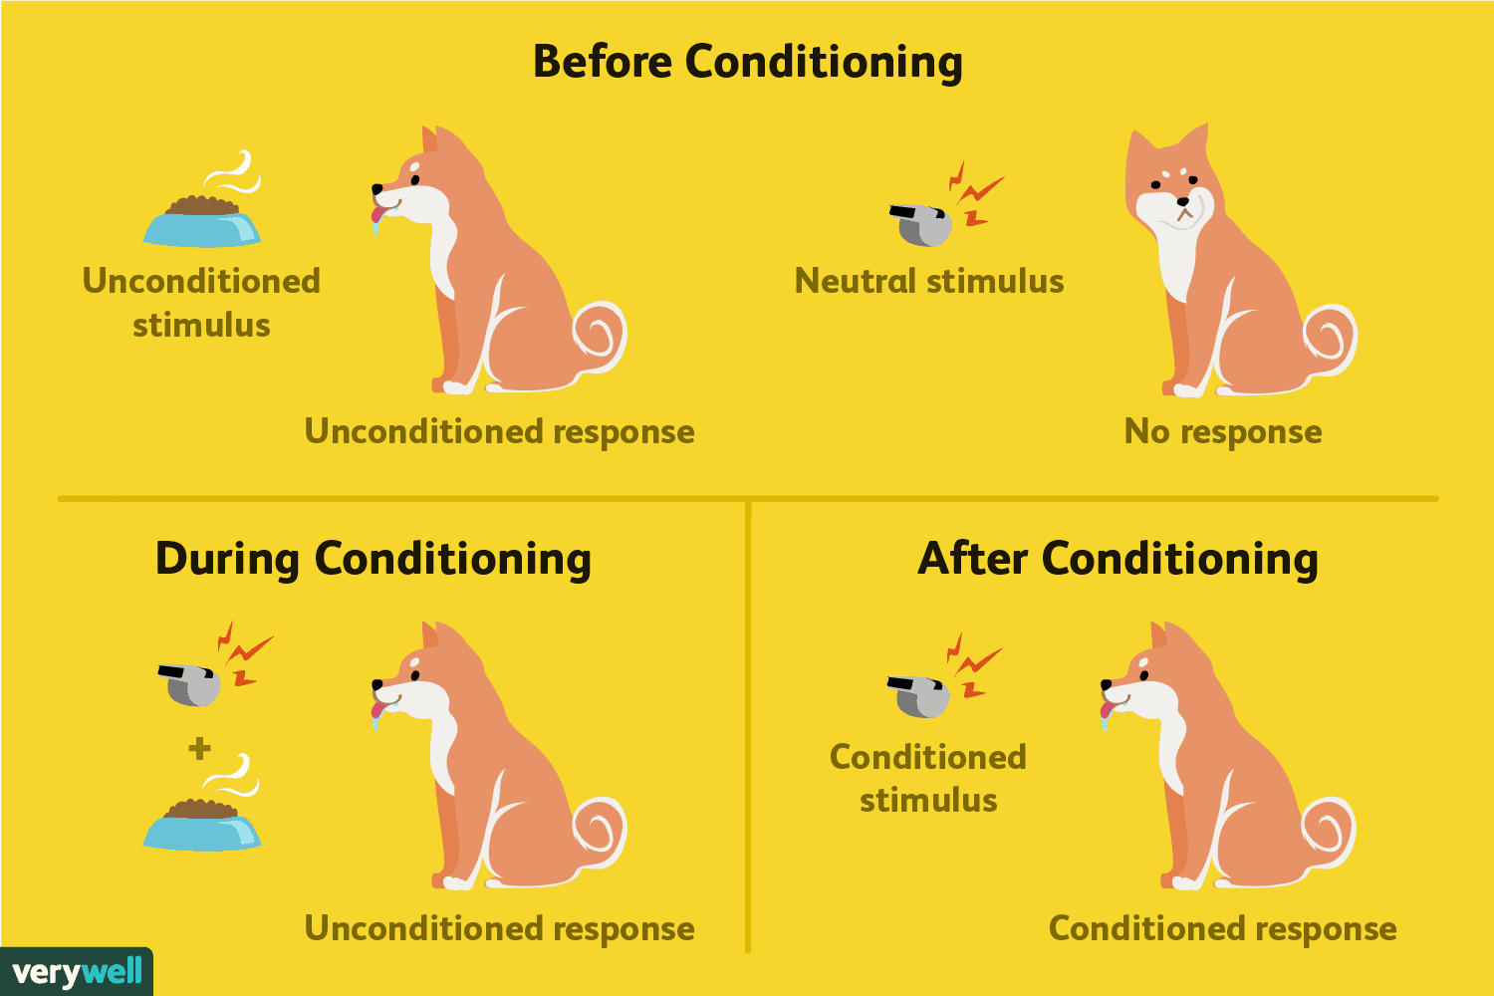
Classical Conditioning

Slide 7
Contiguous Conditioning

Slide 8
Most learning theories can be thought of as attempts to determine the rules by which stimuli and responses become associated.
Edwin Ray Guthrie

Slide 9
Law of Contiguity
“A combination of stimuli which has accompanied a movement will on its recurrence tend to be followed by that movement.”

Slide 10
THE REGENCY PRINCIPLE
Recent stimuli will form associations with an action or movement than previous stimuli
MOVEMENT-PRODUCED STIMULI
Which are caused by movements of the body. If we hear sound and turn toward it, the muscles, tendons, that caused to move

Slide 11
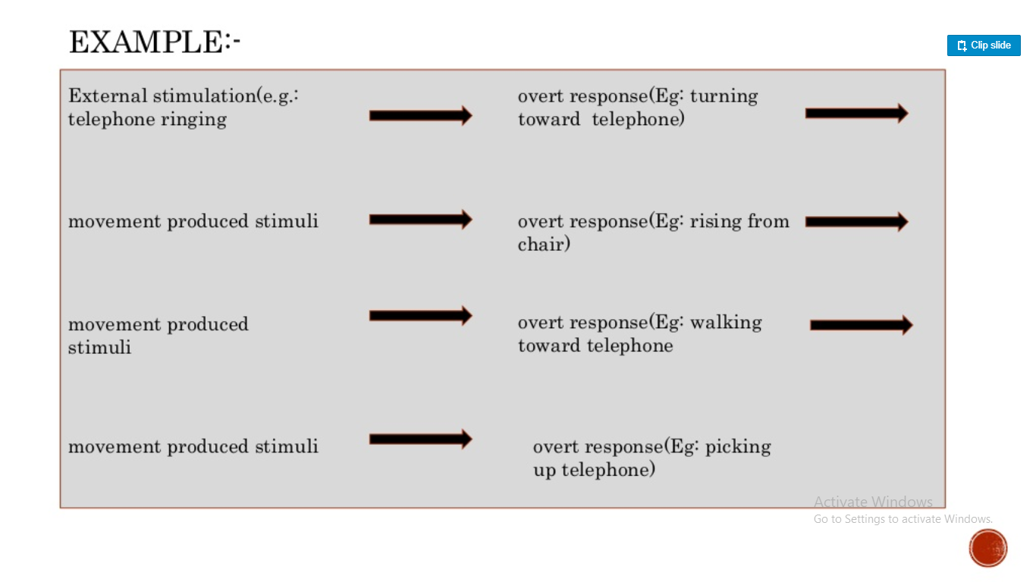

Slide 12
Reward was merely a mechanical arrangement which he felt could be explained by his own law of learning.
Reward

Slide 13
Forgetting
Also occurs in just one trial.
Occur when one habit prevents another due to some stronger stimuli

Slide 14
Threshold
Introduce weak stimulus. Increase stimulus but keep it below threshold value that will produce unwanted response
FATIGUE
Force the child to make unwanted response repeatedly in presenting stimulus
METHOD OF CHANGING HABIT

Slide 15
Punishment
Works not because of the pain experienced by the individual but because it changes the way he responds to certain stimuli

Slide 16
Drives
Maintaining stimuli that keep the organism active until a goal is reached.
Responses that are conditioned to maintaining stimuli
Intention

Slide 17
Transfer of Training
The best place to study is in the room where you are going to be tested because all the stimuli in that room will associated the information that you’re studying.

Slide 18
Stimulus Sampling Theory, was an attempt to develop a statistical explanation for learning phenomena.
William Kaye Estes

Slide 19
Application
SST was conducted using probability or verbal learning experiments, limiting its application to other types of learning.
Different stimulus elements become available or unavailable for sampling due to external or internal variations
Example

Slide 20
Thank you

