Slide 1
Neurophysiology Theories
Dinda Permatasari Harahap
Faculty of Psychology
Universitas Medan Area
dinda@staff.uma.ac.id

Slide 2
Information Processing Theory
Cognitive theory of learning that describe the processing, storage, and retrieval of knowledge in the mind

Slide 3
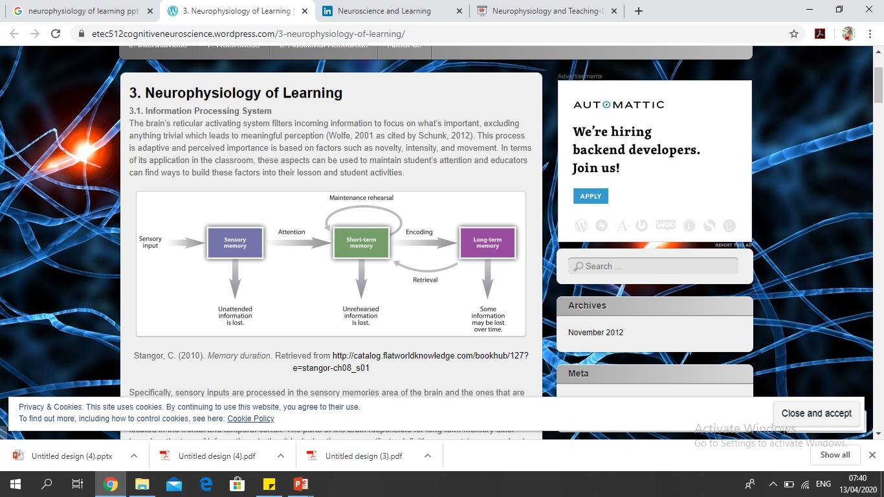
The Sequence of Information Processing

Slide 4
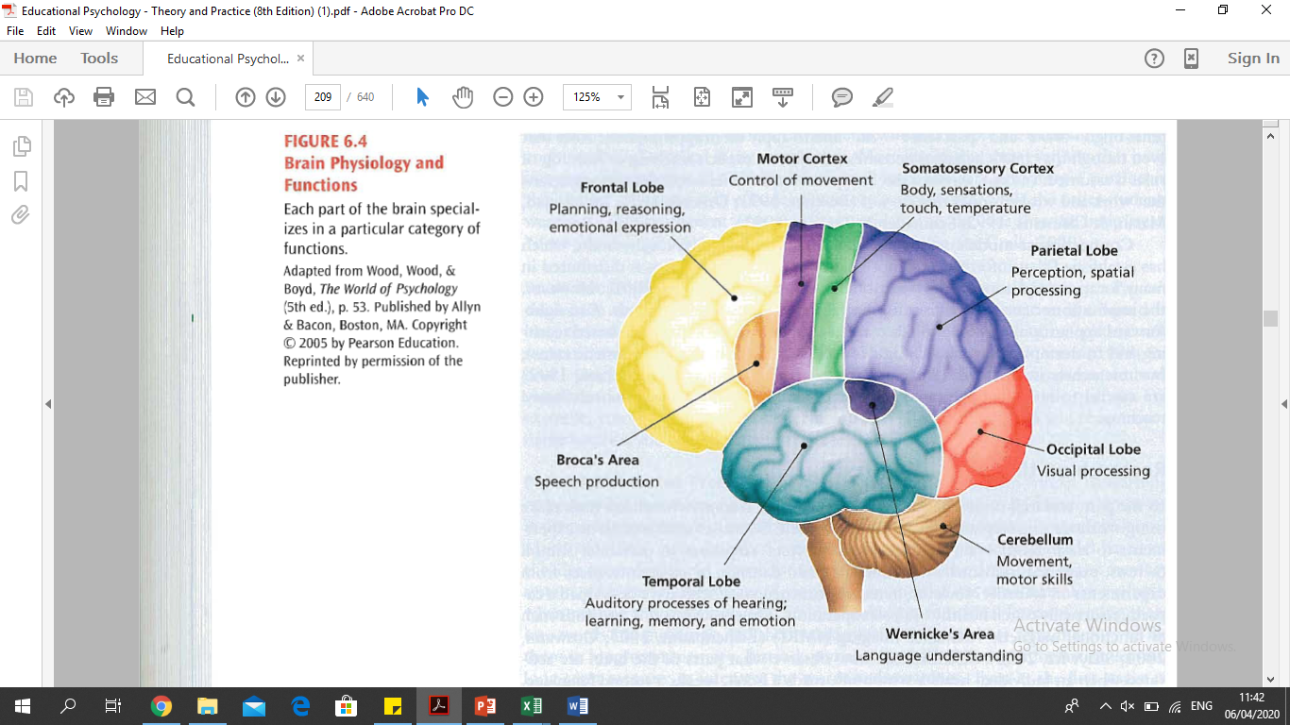
Research on The Brain

Slide 5
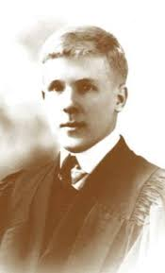
Donald Olding Hebb
1904 - 1985
Principle of Equipotentiality
If one part of the cortex is destroyed, other parts of the cortex take over the destroyed portion’s function.
The Cortex functions as a whole
.

Slide 6
THE BRAIN
Does not act as a simple switchboard, as the behaviourists and associationists had assumed
Hebb’s Three Observations
INTELLIGENCE
Comes from experience and therefore is not genetically determined
CHILDHOOD EXPERIENCES
Are more important in determining intelligence than adult experiences

Slide 7
Major Theoretical Concepts
Restricted Environment
Several experiments demonstrate disabling effects that restricted environment has on early learning and development of the nervous system

Slide 8
Major Theoretical Concepts
Enriched Environment
Greater sensory diversity provided by enriched environment allows animals to build up more numerous and more complex neural circuits or networks

Slide 9
Major Theoretical Concepts
Major Theoretical Concepts
Each environmental object we experience stimulates a complex pattern of neurons called a cell assembly

Slide 10
Memory
CONSOLIDATION THEORY
The contention that STM is converted into LTM
Anythihng that disrupts STM should also disrupt the LTM
ANTEROGRADE AMNESIA
If the hippocampus is damaged, there is failure to learn new information
DECLARATIVE MEMORY
Hippocampal damage interferes with the ability to know that “you know”

Slide 11
Declarative Memory versus Procedural Memory
Procedural memory is knowing “how to” .

Slide 12


Hebb on Education
Early learning characterized by building cell assemblies and phase sequence
Later learning explained more by Gestalt principles than by associationistic one
Suggests different kinds of classrooms for younger versus older learners.

Slide 13
Words of Inspiration
Thank you

