Slide 1
CognitiveTheories
THE INSIGHT LEARNING THEORY
Dinda Permatasari Harahap
Faculty of Psychology
Universitas Medan Area
dinda@staff.uma.ac.id

Slide 2
Purposes that wee see by forming light and dark objects, edges and contours into a whole image without thinking about it
Gestalt Theory

Slide 3
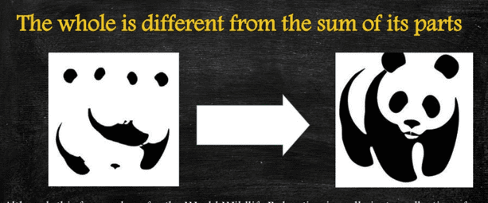
insight
The learning takes place through
Although this famous logo for the World Wildlife Federation is really just a collection of shapes, we make sense of it through the Gestalt principles of figure-ground and closure

Slide 4
Insight
It means sudden grasping of the solution for a problematic situation, a flash of understanding which comes to us all on a sudden.

Slide 5

Educational Implications
WHAT WE AIM TO BE
The teacher should present the subject matter as a whole to facilitate insight learning.
Use of bling fumbling and mechanical trial and error should be minimized.
While planning the curriculum, Gestalt principles should be given due consideration.
Teacher should motivate the child by arousing his interest and curiosity.

Slide 6
Educational Implications
WHAT WE AIM TO BE
The learner must be given opportunities for using his mental abilities.
Learning task must be properly graded according to the intellectual development of the learner.
In order that the learner will be able to solve problems by insight, meaningful learning, learning by understanding and reasoning must be encouraged in the school.

Slide 7
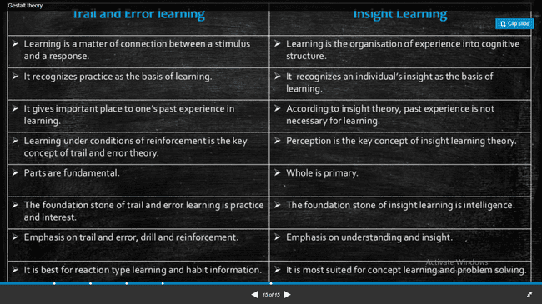

Slide 8
Piaget’s Theory
COGNITIVE DEVELOPMENT
Is the emergence of the ability to think and understand.
The acquisition of the ability to think, reason, and problem solve
The process by which people’s thinking changes across the life span
\

Slide 9
Key Concepts
SCHEMA
Is an internal representation of the world. It helps an individual understand the world they inhabit.
Cognitive structures that represent a certain aspect of the world and can be seen as categories which have certain pre conceived ideas in them

Slide 10


Concepts
Assimilation
Accommodation
Equilibration

Slide 11
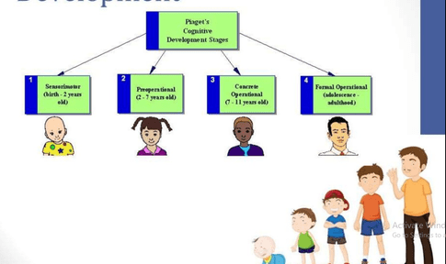

Slide 12
Contribution to Education
Helped educators, parents, and investigators to comprehend the capacity of children in their different stages.
Made us conscious with the way children and adults think.
A lot of school programs have been redesigned taking as base Piaget;s discoveries.
Piaget made a revolution with the developmental pychology concentrating all his attention to the mental process and his role wirh behavior

Slide 13
An organism learns by pursuiong signs to a goal. Learning is acquired through meaningful behaviour.
Edward Chance Tolman

Slide 14
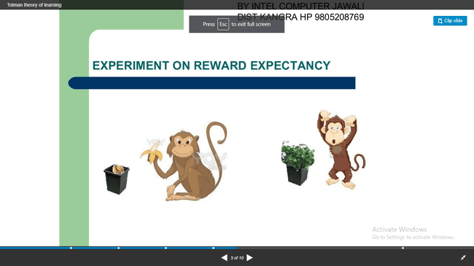
Experiment on Reward Expectancy

Slide 15
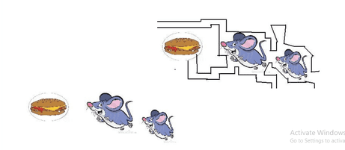
Experiment of Place Learning

Slide 16
LAW OF LEARNING
Capacity Laws
Stimulus Laws
Laws Concerning Manner of Presentation
MDM Inc. | Social Media Strategy

Slide 17

Educational Implications
Defining the goal objects.
Use of Reward and Punishment
Emphasis on Right Methods
Individualised Educations

Slide 18
Factors Affecting Learning
40
30
MOTIVATION
REWARDS AND PUNISHMENT
PROPER ENVIRONMENT
TEACHER BEHAVIOR
WILL POWER
LEARNING BY DOING
PREVIOSE LEARNING
20
10
0
Item 1
Item 2
Item 3
Item 4

Slide 19
Thank You

