Slide 1

Information Processing and Cognitive Theories of Learning
Dinda Permatasari Harahap
Lecturer
Faculty of Psychology
Universitas Medan Area
dinda@staff.uma.ac.id

Slide 2
TODAY'S TOPICS
What is an Information Processing Model?
What Causes People to Remember and Forget?
How Can Memory Strategies Be Taught?
What Makes Information Meaningful?
How Do Metacognitive Skills Help Students Learn?
What Study Strategies Help Student Learn?
How Do Cognitive Teaching Strategies Help Student Learn?
WHAT WE'LL DISCUSS

Slide 3

What is an Information Processing Theory?
Cognitive theory of learning that describe the processing, storage, and retrieval of knowledge in the mind

Slide 4

What is an Information Processing Model?
Sensory Register
Short Term Working Memory
Long Term Memory
Factors that Enhance LTM
Other Information Processing Models
Research on The Brain

Slide 5
What is an Information Processing Model?
SENSORY REGISTER
Receive large amounts of information from each of the senses (sight, hearing, touch, smell, taste) and hold it for a very short time, no more than a couple of second

Slide 6
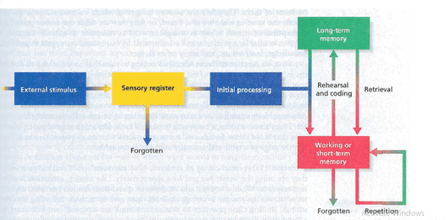
The Sequence of Information Processing

Slide 7
Display Used in Sensory Register
W
R
T
Z
S
H
N
L
D
J
F
X

Slide 8

01
People must pay attention to information if they are to retain it
It takes time to bring all the information seen in a moment into consciousness
02

Slide 9
Perception
Mental interpretation and is influenced by our mental state, past experience, knowledge, motivation and many other factors.
Attention
Active focus on certain stimuli to the exclusion of others
Gaining Attention
“This is important”, Raise or lower the voices, gesture, repetitions, or body position to communicate the same message.

Slide 10
What is an Information Processing Model?
Short Term Memory
The component of memory in which limited amounts of information can be stored for a few second.
Working Memory
Where the mind operates on information, organizes it for storage or discarding and connects it to other information

Slide 11

Working Memory Capacity
WM is believed to have a capacity of 5-9 bits of information.
Flour orange juice pepper
Soda pop parsley cake
Relish mayonnaise oregano
Potatoes milk lettice
Hamburger hot dogs eggs
Tomato apples spaghetti

Slide 12
Individual Differences in Working Memory
One of the main factors in enhancing this capacity is background knowledge. The more person knows about something, the better able the person is to organize and absorb new information

Slide 13
What is an Information Processing Model?
Long Term Memory
That part of our memory system where we keep information for long periods of time
Episodic Memory
A part of LTM that stores facts and general knowlegde
Procedural Memory
A part of LTM that stores information about how to do things

Slide 14
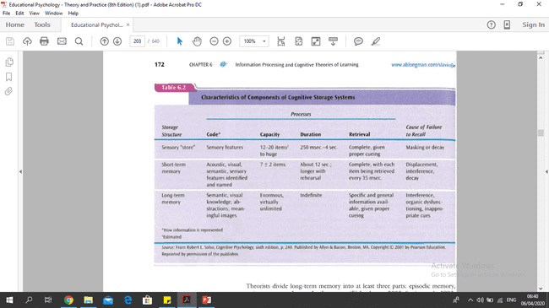

Slide 15
What is an Information Processing Model?
Semantic Memory
Is organized in a very different way
Schema
Mental networks of related concepts that influence understanding of new information

Slide 16
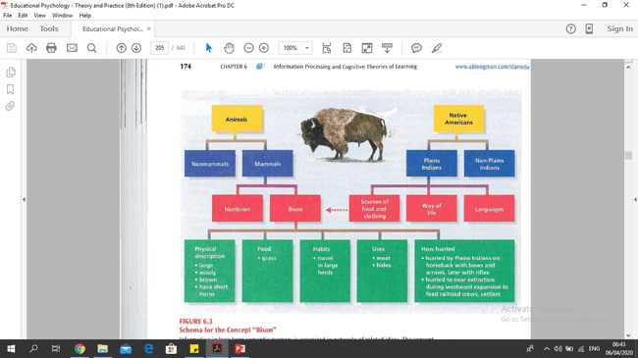

Slide 17
Other Information Processing Models
LEVELS OF PROCESSING THEORY
Explanation of memory that links recall of a stimulus with the amount of mental processing it receives
Ex : You may perceive the tree but pay little attention to it (lowest level)
2nd : Give the tree name
3rd : Giving meaning to the tree

Slide 18
Other Information Processing Models
DUAL CODE THEORY
Information is retained in LTM in two forms : visual and verbal (corresponding to episodic and semantic memory, respectively)
Parallel Distributed Processing Model
information is processed simultaneously in the three parts of the memory system, each part operating on the same information at the same time

Slide 19

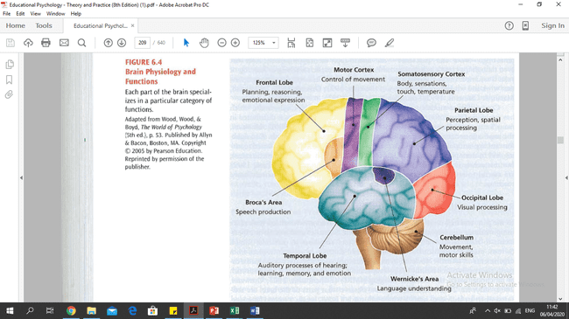
Research on The Brain

Slide 20
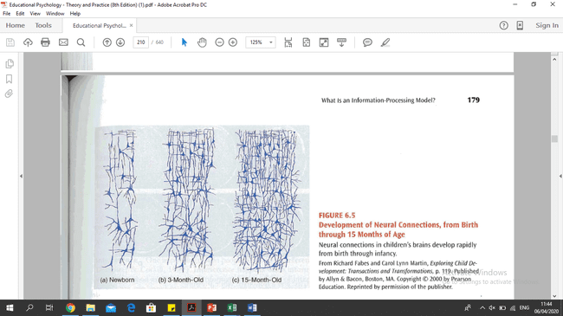
Development of Neural Connection

Slide 21
What causes People to Remember or Forget?
Forgetting and Remembering
Practice

Slide 22
Forgetting & Remembering
Interference
Happens when information gets mixed up with, or pushed aside by, other information
Retroactive Inhibition
This occurs when previously learned information is lost because it is mixed up with new and somewhat similar information.

Slide 23
Forgetting & Remembering
Proactive Inhibition
Occurs when learning one set of information interferes with learning later information
Individual Differences in Resistance to Interference
This occurs when previously learned information is lost because it is mixed up with new and somewhat similar information.

Slide 24
Practice
Massed Practice
practice newly learned information r intensively until it is thoroughly learned,
Distributed Practice
Practice a little each day over a period of time

Slide 25
How Can Memory Strategies Be Taught
Verbal Learning
Paired Associate Learning
Serial and Free Recall Learning

Slide 26
Verbal Learning
Paired associate learning
Serial Learning
Free recall learning

Slide 27
Paired-Associate Learning
Learning of items in linked pairs so that when one member of a pair is presented, the other can be recalled.
Imagery
Mental visualization of images to improve memory.

Slide 28
What Makes Information Meaningful?
Rote versus Meaningful Learning
Schema Theory

Slide 29
What Study Strategies Help Student Learn?
Note taking
Underlining
Summarizing
Writing to Learn
Outlining and Mapping
PQ4R Method

Slide 30
How Do Cognitive Teaching Strategies Help Students Learn?
Making Learning Relevant and Activating Prior Knowledge
Organizing Information

Slide 31
Thank you.

