Slide 1
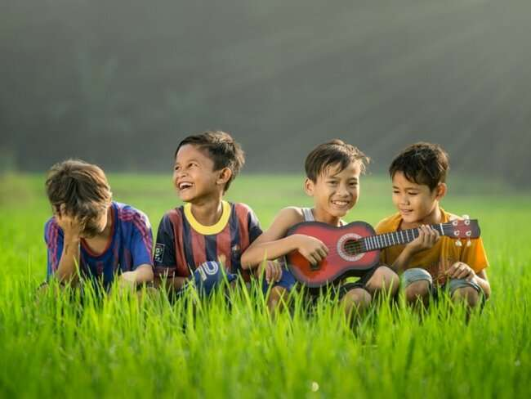
Development During Childhood & Adolescence
DINDA PERMATASARI HARAHAP

Slide 2
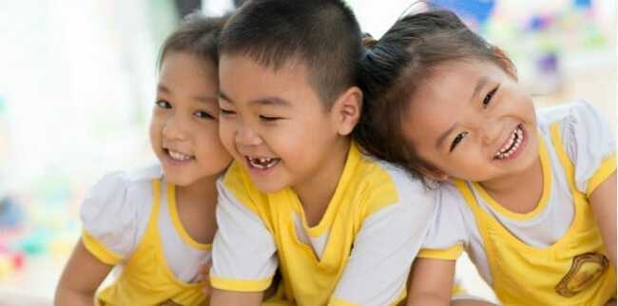
We will Learn about
How Do Children Develop during the Preschool Years?
Physical Development in Early Childhood
Language Acquisition
Emotional Development
02

Slide 3
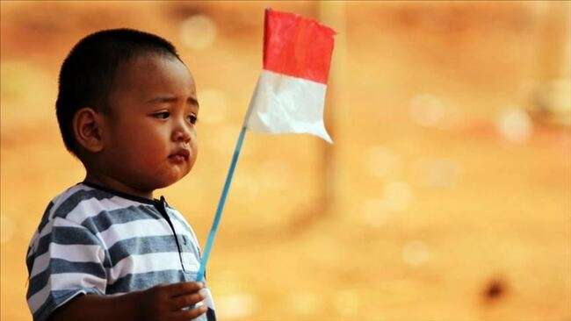
Development in Early Childhood
Cognitive
Social
Physic
Start to develop an understanding of el and relationships and absorb an enormous amount of information about their social and physical worlds
Learn appropriate behaviors and rules and become increasingly adept at interacting with other children. .
Master motor skills

Slide 4
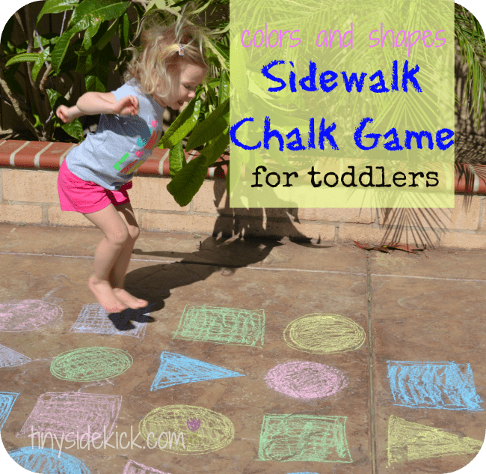
Physical Development in Early Childhood
Small muscle development
Large muscle development
perform s tasks such as buckling, buttoning, snapping, and zipping. .
begining to write letters and words.

Slide 5
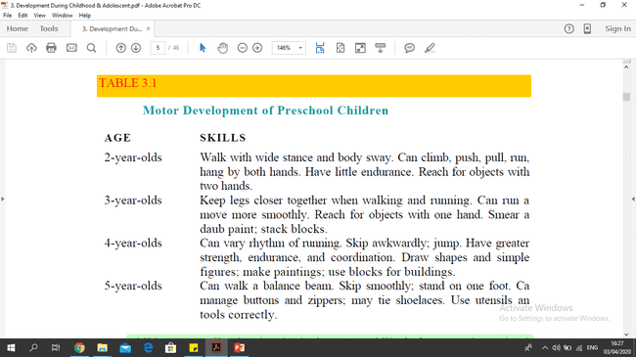

Slide 6
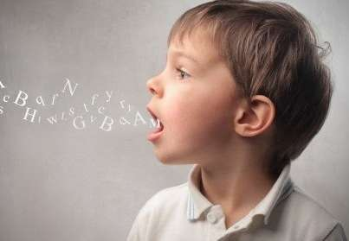
Language Acquisition
0-2 years
3 years
5-6
Understand their world through senses
Produce one word utterances
Use and understand an almost infinite number of sentences, can hold conversations, know bout written language
Already skillful talkers

Slide 7
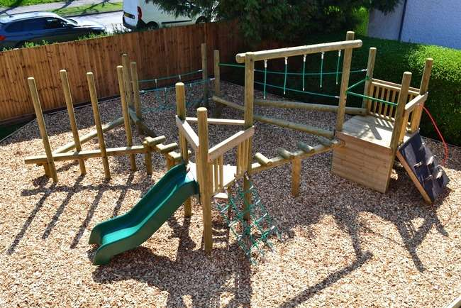
We will Learn about
What Kinds of Early Childhood Education Program Exist?
Day Care Programs
Preschools
Compensatory Preschool Programs
Early Intervention
Kindergarten Program
Developmentally Appropriate Practice
02

Slide 8
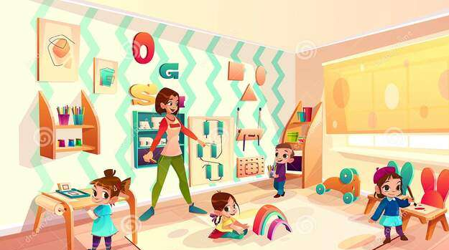
DAY CARE PROGRAM
Exist for children from infancy on, and organized preschool programs sometimes take children as young as 2
Provide Child-care services for working parents
07

Slide 9
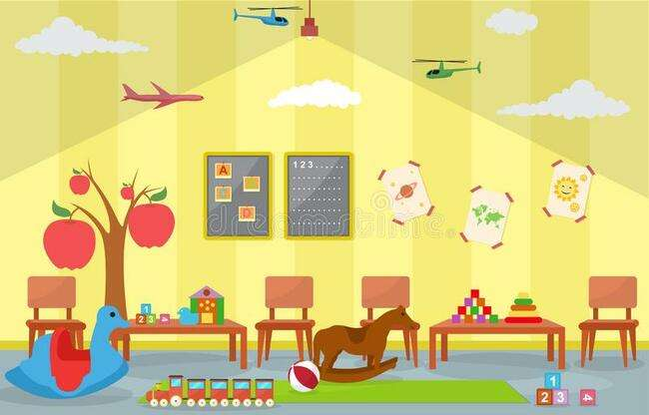
PRESCHOOL
Provide a planned program designed to foster the social and cognitive development of young children
07

Slide 10
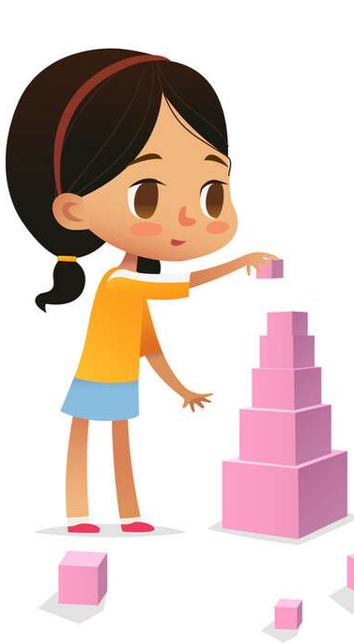
To give disadvantaged children, who are (as a group) at risk for school failure
Chance to start their formal schooling with the same preacademic and social skills that middle-class children possess
Compensatory Preschool Program
16

Slide 11
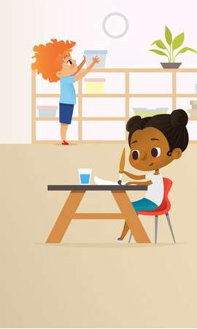
Is needed for children who are at the greatest risk for school failure
Have been developed to start with children as young as 6 months old
Early Intervention
16

Slide 12
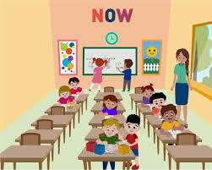
To prepare children for formal instruction by encouraging development of their social skills
Emphasizing prereading and premathematical skilss
Kindergarten Program

Slide 13
Instruction based on students’ individual characteristics and needs, not their ages
One type of developmentally appropriate practice was developed by Maria Montessori (1870-1952)
Developmentally Appropriate Practice

Slide 14

We will Learn about
How Do Children Develop during the Elementary Years?
Physical Development during Middle Childhood
Cognitive Abilities
Socioemotional Development in Middle Childhood
02

Slide 15
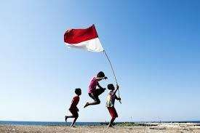
Physical Development in Early Childhood
Girls are slightly shorter and lighter than boy until around the age of 9
Developed many of the basic motor skills they need for balance, running, jumping, and throwing
Males are 12 to 18 months behind girls in development

Slide 16
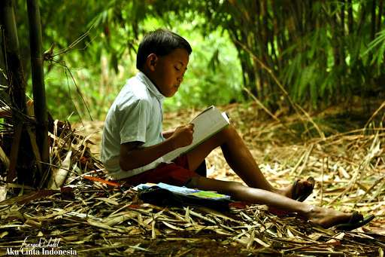
Cognitive Abilities in Middle Childhood
Transition from the stage of preoperational thought to te concrete operations
Rapidly developing memory and cognitive skills
Ability to think about their own thinking and ti learn how to learn

Slide 17

Socioemotional in Middle Childhood
Have developed skills for more complex thought, action, and social influence
Start trying to prove that they are grown up
I can do it my self
Spend more time chosen tasks, completing projects

Slide 18

SELF CONCEPT
The way in which we perceive our strengths, weakness, abilities, attitudes, and values
SELF ESTEEM
How we evaluate our skills and abilities.
05

Slide 19

How Do Children Develop during the High School Years?
Physical Development during Adolescence
Cognitive Development
Characteristics of Hypothetical Deductive Reasoning
Socioemotional Development in Adolescence
Identity Development
Self Concept and Self Esteem
Social Relationships
Emotional Development
Problems of Adolescence

Slide 20
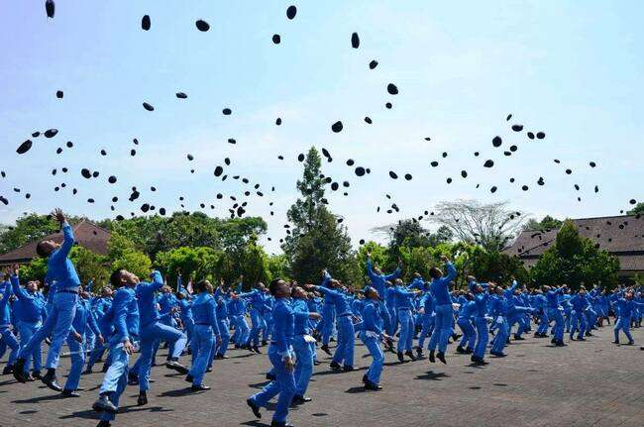
Physical Development during Adolescence
Puberty is a series of physiological changes that render the immature organism capable of reproduction

Slide 21
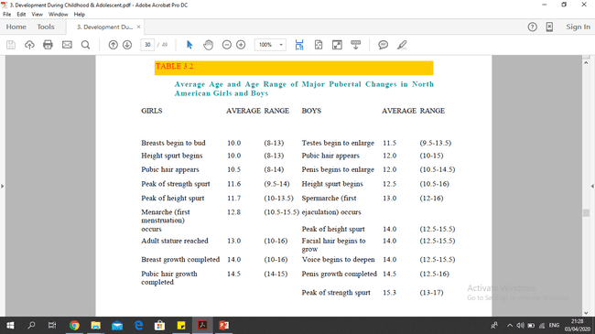

Slide 22
Cognitive Development
Formal operations in reasoning
Experience with complex problem
Demand of dormal instructions
Exchange and contradictions of ideas with peers

Slide 23
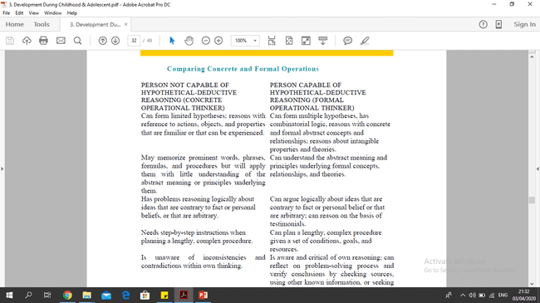

Slide 24
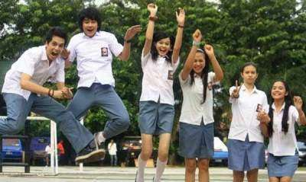
Adolescence
Groups
Membership in groups tends to promote feelings of self worrth.
Twant their parents to treat them differently
Socioemotional Development
Adolescence will
Tell teachers personal information they would not tell their parents.
1

Slide 25

Emotional Development
Most adolescents experience emotional conflicts at some point
Emotional distress is temporary and is successfully handled, but for some the stresses lead to delinquency, drug abuse, or suicide attempts

Slide 26

Problems of Adolescence
Emotional Disorders
Bullying
Dropping out
Drug and Alcohol Abuse
Delinquency
Risk of pregnancy

Slide 27


