Slide 1

Theories of Development
Dinda Permatasari Harahap
Lecturer
Faculty of Psychology Universitas Medan Area
dinda@staff.uma.ac.id

Slide 2


Dinda Permatasari Harahap, M.Psi, Psikolog
Lecturer
Psychologist
Writer

Slide 3


Slide 4
We’ll learn about
1. Explore the meaning of HUMAN DEVELOPMENT
3. DEVELOPMENTAL ISSUE
4.DEVELOPMENT AND EDUCATION
2. PROCESS AND PERIOD

Slide 5
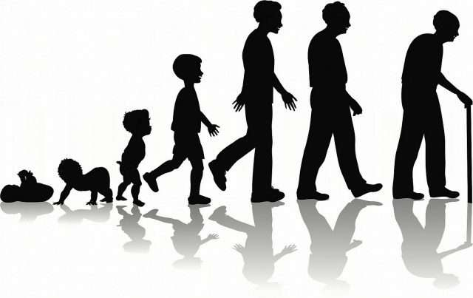
EXPLORATION THE MEANING OF HUMAN DEVELOPMENT

Slide 6
Life changing?
Experiences?
Maturity?
What do you think about
HUMAN DEVELOPMENT?
Anything else?

Slide 7
8 Facts about Development
The role of maturity and learning
There is a pattern and can be predicted
Individual differences
Each stage has different behavior and characteristic
Each stage has risk

Slide 8
8 Facts about Development
Development is influenced by culture
Social expectation on each stage
Task must be completed on each stage

Slide 9

CHILD DEVELOPMENT

Slide 10
Why do We Learn bout Child Development
1. Understanding children development so you can understand the good method for them
4. Developmental Milestone
2. Golden Age Moment
5. What else?
3. Special Growth and Life Changing

Slide 11
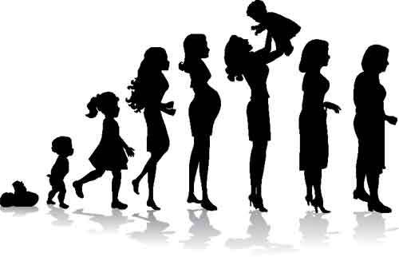
The Changing of biology, cognitive, and socio emotional aspects
which started from fertilization till throughout the life span

Slide 12
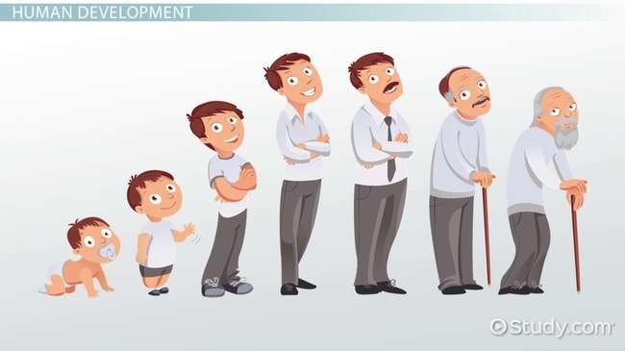
PROCESS AND PERIOD

Slide 13
Biological Process
The changing of child’s body which underlie brain development, height and weight, motoric skills, the changing of puberty hormon
Cognitive Process
The changing of thinking, intelligence, and children language
Ex : poem, creative strategy for mathematic, speech
Socioemotional Process
Children relationship with people, family, peers, emotional changing, personality, parenting,

Slide 14

HUMAN DEVELOPMENTAL PERIOD

Slide 15
HUMAN LIFE STAGE
Early Childhood
(2-5 yo)
Adolescence
(10-12 and 18-21)
Infantil
(18-24 mo)
Midle and The end of
Childhood
(6-11 yo)
Adult
(20-30 yo)

Slide 16

DISCUSSION
Try to find out the characteristic on each stages!

Slide 17
HUMAN DEVELOPMENTAL ISSUE

Slide 18
Nature and Nurture
Does the development influenced by nature or nurture?
Continuity and Discontinuity Issue
Proponents of the continuity view say that development is a continuous process that is gradual and cumulative. For example, a child learns to crawl, and then to stand and then to walk.
The discontinuity view of development believes that people pass through stages of life that are qualitatively different from each other.

Slide 19
Early Experiences
Experience plays an essential role in building brain architecture after birth

Slide 20

DEVELOPMENT AND EDUCATION

Slide 21
Related Issue
Learning process and understanding human development
Splintered Development
Different characteristic of Children
Age, skill, prior knowledge
Brain development
(reading and writing)
Competence teacher

Slide 22
Cognitive Development
Brain
Piaget Theory
Vygotsky

Slide 23
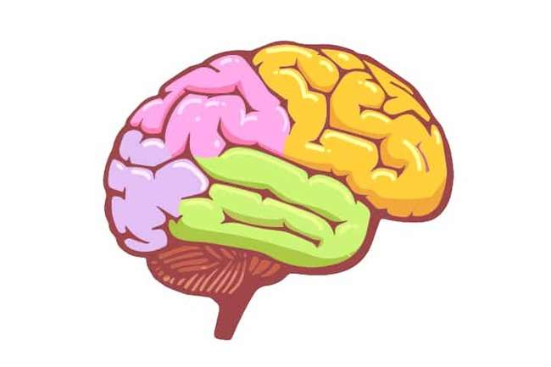
Human Brain

Slide 24
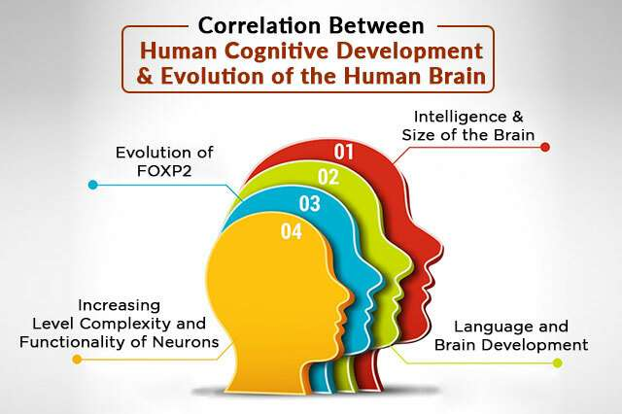

Slide 25
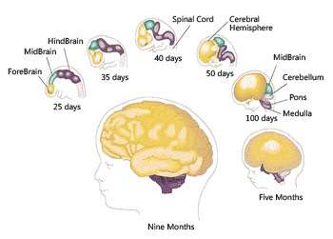

Slide 26
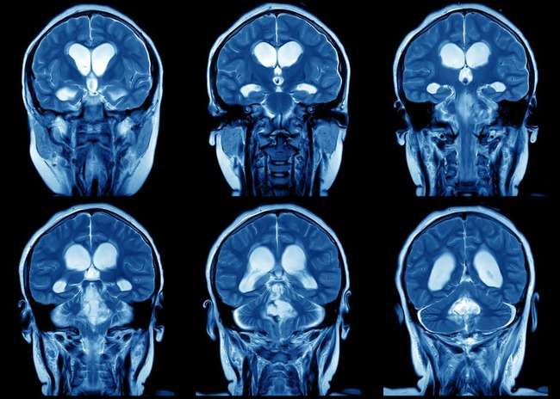
Neuroplasticity
Neuroplasticity – or brain plasticity – is the ability of the brain to modify its connections or re-wire itself.
Without this ability, any brain, not just the human brain, would be unable to develop from infancy through to adulthood or recover from brain injury

Slide 27
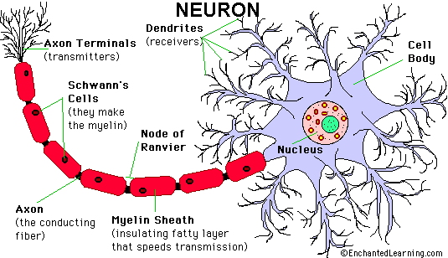
Human Brain Cells and Neuron

Slide 28
Myelin is related with the coordination of hand and sight till age 4
Myelin can influence the focus of children
Myelin is in frontal lobe of human brain

Slide 29
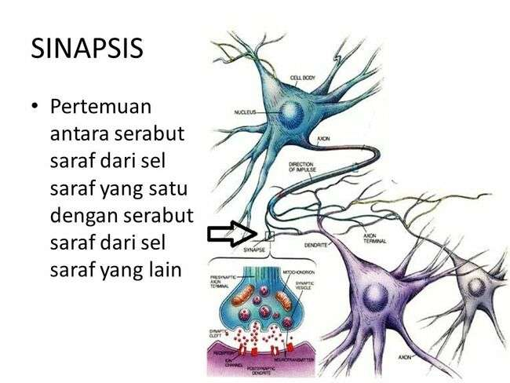
The Connection Among Neuron

Slide 30
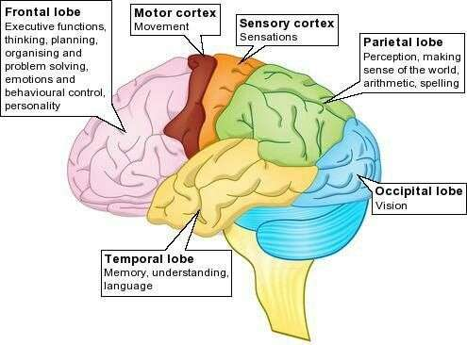

Slide 31
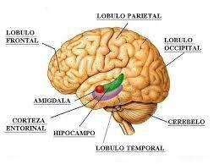
Amigdala
Processing information about emotion
Prefrontal Cortex
Higher level cognitive : decision making

Slide 32
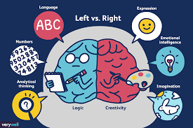
Left vs Right
Brain

Slide 33

Brain and Children’ Education

Slide 34
Educational Practice and Human Brain
Environment that stimulates children’s brain
The expectation of their changing
Sesnitive period
The learning process is happen when the synaps become consistent

Slide 35
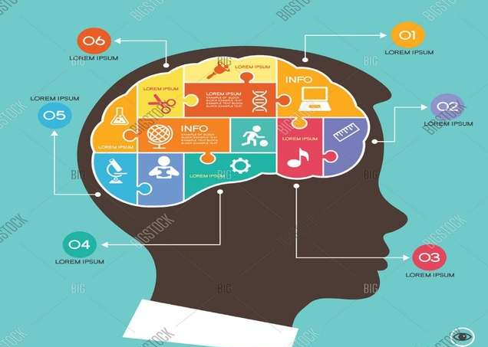
Piaget Theory Cognitive Development

Slide 36
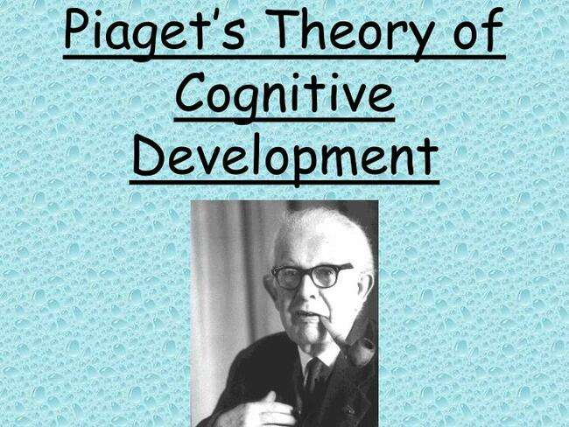
Jean Piaget (1896 – 1980)
Was born in Nauchatel, Switzerland, 9 August 1896
A writer in 10 y.o
PhD in 22 y.o in zoology
1914 – 1918 Formal Education
1918 – 1921 From Scientist to Psychologist

Slide 37
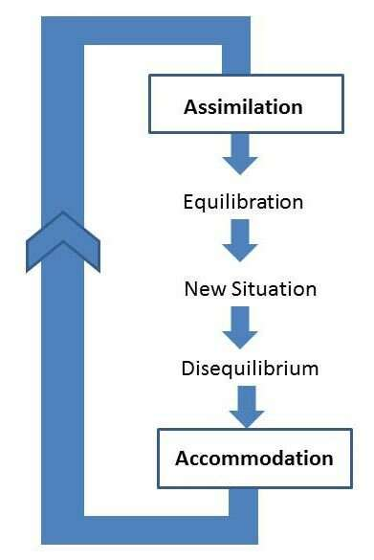
Cognitive Process

Slide 38
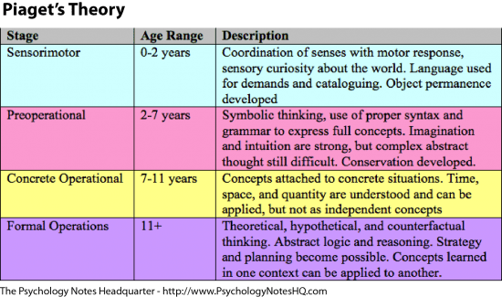

Slide 39
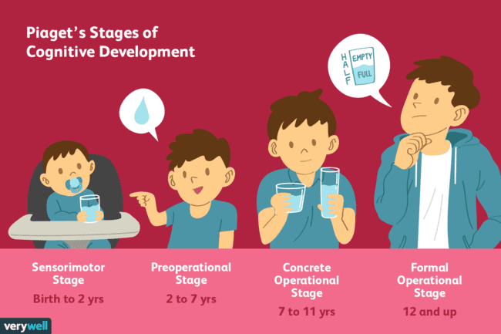

Slide 40
Vygotsky Sociocultural Theory

Slide 41
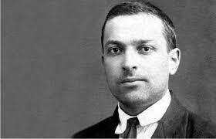
LEV SEMYONOVICH VYGOTSKY
1896 - 1934
Was born on November 17th 1896 in Russia
Moscow Institute 1925

Slide 42
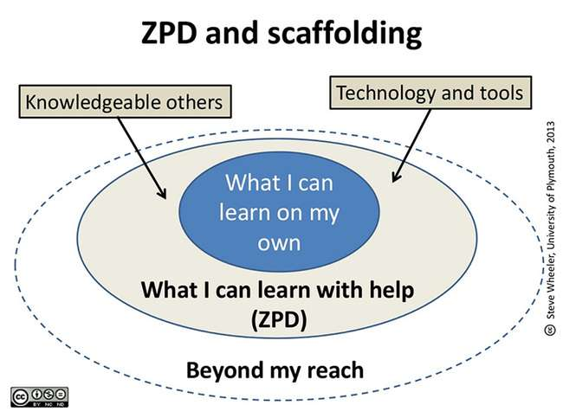

Slide 43
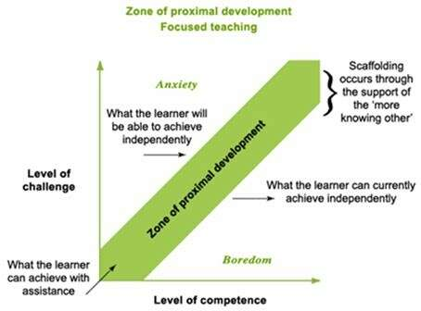

Slide 44

Language Development

Slide 45
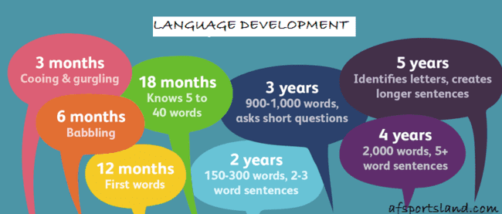

Slide 46
Children Language Development
0-3
y.o
3-4
y.o
5
y.o
6
y.o
Knowing book from its cover, emergent literacy, games of word/song, listening to the story telling, write letter
Knowing alphabet, sound has a different sound, interesting to the book, writing
Capital letter, write their name
Read syllable, predict a moment in book story, writing meaningfull word

Slide 47
Language Development is Influenced by
The growing of mouth, tounge, position of laring
Brain structural ex frontral and temporal lobus
Biological
1
Literacy activity at home
Family
2
School
3
Scaffolding by the teacher at school

Slide 48
Language Development Aspect
Fonologi
Morfologi
Semantik
Pragmatik
Sintaks
Sound in language
Smallest unit in language
Word -> sentence
Understanding the meaning of words
Using language in daily life

Slide 49
TUGAS AKHIR
Membuat Film Edukasi dengan Konten Psikologi Pendidikan
Tugas diupload di YOUTUBE

Slide 50
Thank you

