Slide 1

Student Diversity
Dinda Permatasari Harahap
Faculty of Psychology Universitas Medan Area
dinda@staff.uma.ac.id

Slide 2

We Will Learn About
01
What is the Impact of Culture on Teaching and Learning?
02
How Does Socioeconomic Status Affect Student Achievement?
03
School Family and Community Partnerships

Slide 3
We Will Learn About
04
How Do Ethnicity and Race Affect Students School Experiences?
05
How Do Language Differences and Bilingual Programs Affect Student Achievement?
06
What is Multicultural Education? What is Multicultural Education?

Slide 4
We Will Learn About
07
How do Gender and Gender Bias Affect Students School Experiences?
08
How Do Students Differ in Intelligence and Learning Styles

Slide 5
When children enter school, they have absorbed many aspects of theculture in which they were raised, such as language, beliefs, attitudes, ways of beculture having, and food preferences.
What is the Impact of Culture on Teaching and Learning?

Slide 6
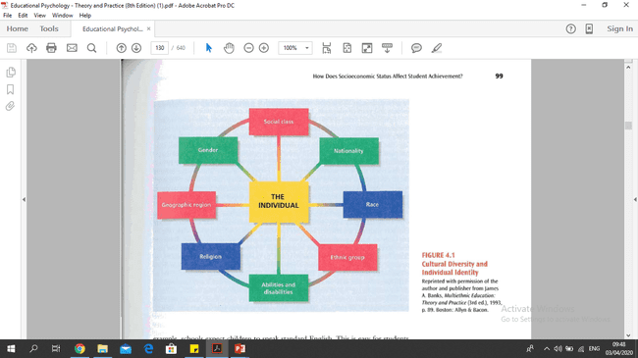

Slide 7
Socioeconomic status (SES), in terms of an individual's &come, occupation, education, and prestige in society.
Students' social-class origins are likely to have a profound effect on attitudes and behaviors in school.
Students from working-class or lower-class backgrounds are less likely than middle-class students to enter school knowing how to count, to name letters, to cut with scissors, or to name colors.
How Does Socioeconomic Status Affect Student Achievement?

Slide 8
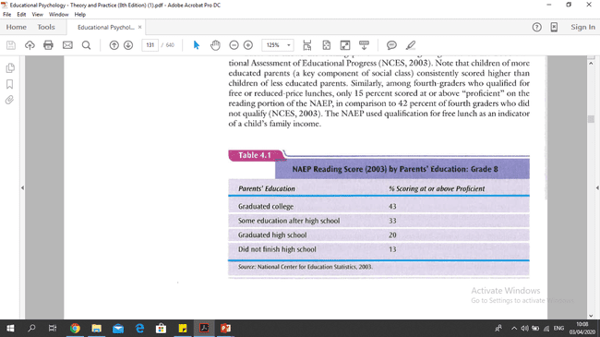

Slide 9
The Role of Child-Rearing Practices
Focused on the differences in chld-rearing practices between the average middle-class family and the average working-class or lower-class family
Middle-class children are liltely to be good at following directions, explaining and understanding reasons, and comprehending and using complex language, while worng-class or lower-class children may have less experience in all these areas (Slaughter & Epps, 1994).

Slide 10
The Link between Income and Summer Learning
Environment
LOW SES
HIGH SES
Progress in academic achievement during the school year
academic
readiness for school,
the level of achievement throughout students
Influence

Slide 11
The Role of Schools as Middle-Class Institution
The school overwhelmingly represents the values and expectations of the middle class
Children should do their own work.
Middle Class
Helping others is often defined as cheat
Are expected to compete for grades,

Slide 12
The Role of Schools as Middle-Class Institution
are less willing to compete and are more interested in cooperating with their peer.
Low Class
learned from an early age to rely on their communities, friends, and family and have always also helped and been helped by others

Slide 13
The Role of Child-Rearing Practices
Focused on the differences in chlid-rearing practices between the average middle-class family and the average working-class or lower-class family
Middle-class children are lately to be good at following directions, explaining and understanding reasons, and comprehending and using complex language, while working-class or lower-class children may have less experience in all these areas

Slide 14
School, Family, and Community Partnership
Six types of involvement schools might emphasize in a comprehensive partnership with parents
Parenting
Communicating
Volunteering
Learning at Home
Decision Making
Collaborating with the Community

Slide 15
Is the Low Achievement of Children From Low-Income Groups Inevitable?
School can do a great deal to enable children from low income families to succeed in school

Slide 16
HOW DO ETHNlClTY AND RACE AFFECT STUDENTS‘ SCHOOL EXPERIENCES?
one in which individuals have a shared sense of identity, usually because of a common place of origin (such as Swedish, Greek Americans), religion, or race (such as Africanor Asian Americans).
Ethnic Group
Race
refers only to physical characteristics, such as skin color.

Slide 17
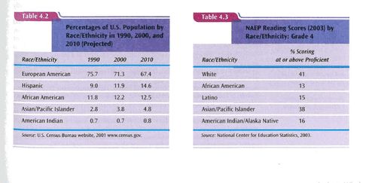
WHY HAVE STUDENTS FROM UNDER-REPRESENTED GROUPS LAGGED IN ACHIEVEMENT?

Slide 18
How Do Language Differences and Bilingual Programs Affect Student Achievement?
Students with limited English proficiency present a dilemma to the educational system

Slide 19
Bilingual Education
English Immersion
Transitional bilingual education
Paired bilingual education
Two way bilingual education

Slide 20
Multicultural education as encompassing all policies and practices schools might use to improve educational outcomes not only for students of different ethnic, social class, and religious backgrounds, but also for students of different genders and exceptionalities (e.g., children who have mental retardation, hearing loss, or vision loss or who are
gifted).
What is Multicultural Education?

Slide 21
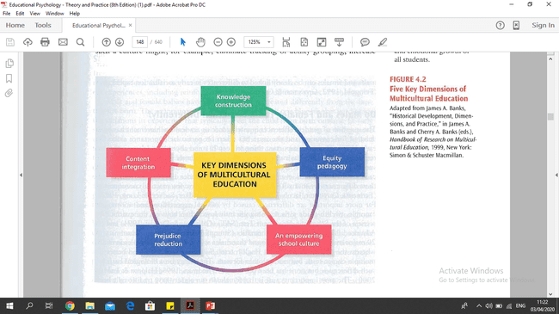

Slide 22
How do Gender and Gender Bias Affect Students’ School Experiences?
Gender roles are among the first that individuals learn and that all societies treat males differently from females

Slide 23
Do Males and Females Think and Learn Differently?
Twelfth-grade girls score significantly lower than boys on the quantitative section of the Scholastic Assessment Test (SAT) (Gallagher & De Lisi, 1994)
Males scored better than females in math, whereas the opposite was true on English tests (Kim, 2001)

Slide 24


