Slide 1
PERSPECTIVE ON EFFECTIVE LEADERSHIP BEHAVIOR
Rizty Desta Mahestri, M.Psi., Psikolog – Fakultas Psikologi Universitas Medan Area

Slide 2
effective leadership?

Slide 3
Researches on effective leadership

Slide 4
OHIO STATE LEADERSHIP STUDIES
CONSIDERATION
INITIATING STRUCTURE
Subordinates perceived their supervisor’s behavior

Slide 5
OHIO STATE LEADERSHIP STUDIES
Consideration
leader concern for people and interpersonal relationships
Initiating Structure
concern for accomplishing the task

Slide 6
OHIO STATE LEADERSHIP STUDIES
RESULT
A positive relationship between consideration and subordinate satisfaction

Slide 7
MICHIGAN LEADERSHIP STUDIES
The research found 3 types of leadeship behavior
Task-oriented behavior
Relationship-oriented behavior
Participative leadership

Slide 8
MICHIGAN LEADERSHIP STUDIES
“Task-Oriented Behavior. planning and scheduling the work, coordinating subordinate activities, and providing necessary supplies, equipment, and technical assistance.
Moreover, effective managers guided subordinates in setting performance goals that were high but realistic”

Slide 9
MICHIGAN LEADERSHIP STUDIES
”Relation-Oriented Behavior. Showing trust and confidence, friendly and considerate, trying to understand subordinate problems, helping to develop and further their careers, keeping subordinates informed, showing appreciation for ideas, allowed considerable autonomy in how subordinates do the work, and providing recognition”

Slide 10
MICHIGAN LEADERSHIP STUDIES
“Participative leadership. The role of the manager in group meetings should be primarily to guide the discussion and keep it supportive, constructive, and oriented toward problem solving”

Slide 11
EXPERIMENTS ON TASK AND RELATION BEHAVIOR
increases in relations-oriented leadership behavior usually resulted in higher subordinate satisfaction and productivity

Slide 12
THE MOST EFFECTIVE TYPE OF LEADER BEHAVIOR WERE FOUND IN MOST OF THE STUDIES :
Planning, coordinating, and organizing operations
Supervising subordinates (directing, instructing, monitoring performance)
Establishing and maintaining good relations with subordinates
Establishing and maintaining good relations with superiors, peers, and outsiders
Assuming responsibility for observing organizational policies, carrying out required duties, and making necessary decisions

Slide 13
THE HIGH-HIGH LEADER
BLAKE & MOUTON, 1960s
Effective managers have a high concern for both people and production

Slide 14
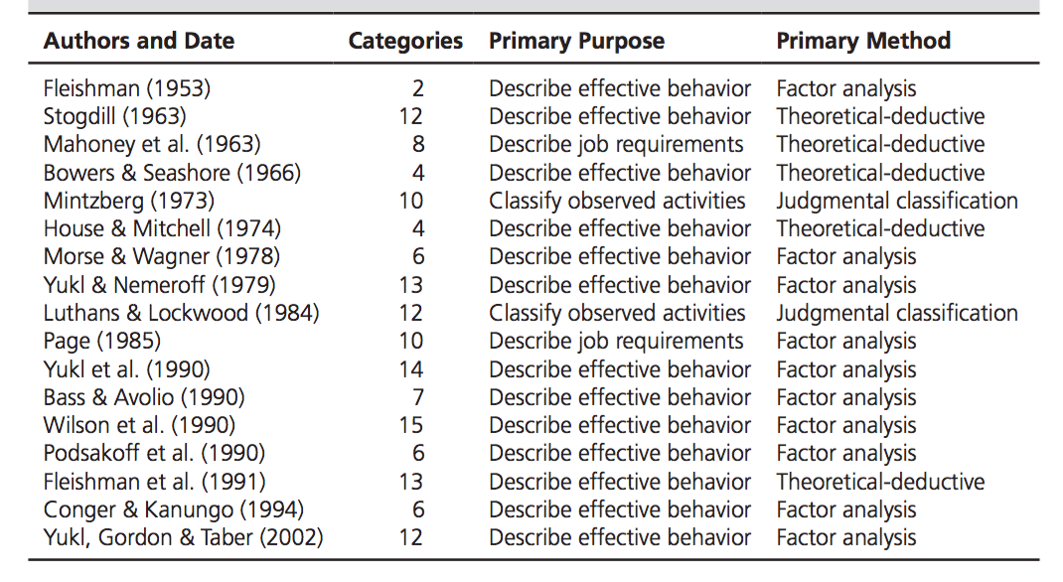
LEADERSHIP BEHAVIOR TAXONOMIES

Slide 15
A THREE-DIMENSIONAL MODEL
Change Oriented Behavior
Relation Oriented Behavior
Task Oriented Behavior

Slide 16
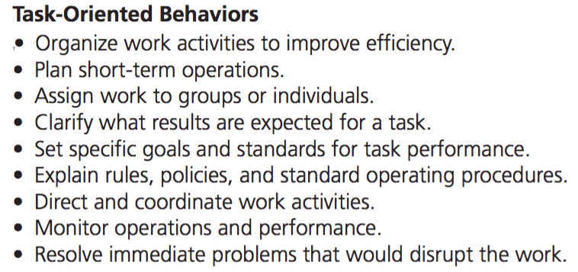
EXAMPLE OF TASK, RELATIONS, AND CHANGE BEHAVIOR

Slide 17
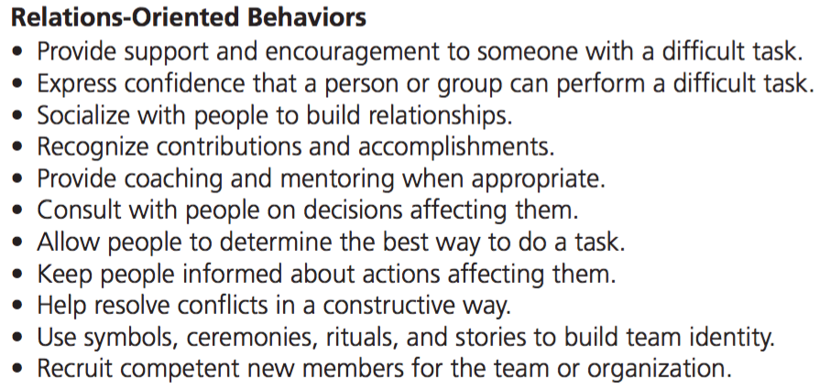
EXAMPLE OF TASK, RELATIONS, AND CHANGE BEHAVIOR

Slide 18
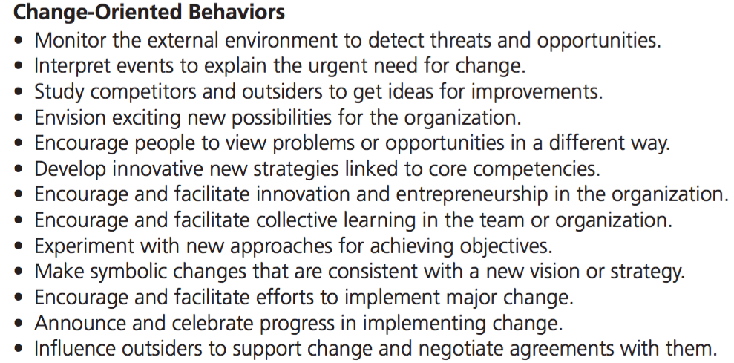
EXAMPLE OF TASK, RELATIONS, AND CHANGE BEHAVIOR

Slide 19
SPECIFIC TASK BEHAVIORS
Planning work activities
Clarifying roles & objectives
Monitoring operations & performance

Slide 20
SPECIFIC TASK BEHAVIORS
Operational Planning
s the scheduling of routine work and determination of task assignments for the next day or week
Action Planning
the development of detailed action steps and schedules for implementing a new policy or carrying out a project
Contingency Planning
the development of procedures for avoiding or coping with potential problems or disasters
Planning Work Activities : deciding what to do, how to do it, who will do it, and when it will be done

Slide 21
SPECIFIC TASK BEHAVIORS
Defining job responsibility & requirement
Setting performance goal
Assigning specific task
Clarifying Roles & Objectives : is the communication of plans, policies, and role expectations

Slide 22
SPECIFIC TASK BEHAVIORS
Monitoring behavior can take many forms, including observation of work operations, reading written reports, watching computer screen displays of performance data, inspecting the quality of samples of the work, and holding progress review meetings with an individual or group.
The appropriate type of monitoring depends on the nature of the task and other aspects of the situation
Monitoring Operation & Performance :
gathering information about the operations of the manager’s organizational unit, including the progress of the work, the performance of individual subordinates, the quality of products or services, and the success of projects or programs.

Slide 23
SPECIFIC RELATIONS BEHAVIORS
Supporting
Recognizing
Developing

Slide 24
SPECIFIC RELATIONS BEHAVIORS
Supporting : consideration, acceptance, and concern for the needs and feelings of other people

Slide 25
SPECIFIC RELATIONS BEHAVIORS
Developing : several managerial practices that are used to increase a person’s skills and facilitate job adjustment and career advancement. Component behaviors include coaching, mentoring, and career counseling

Slide 26
SPECIFIC RELATIONS BEHAVIORS
Recognizing : giving praise and showing appreciation to others for effective performance, significant achievements, and important contributions to the organization

Slide 27
THANK YOU

