Slide 1
Development & Implementation of Training
Cut Sarah, M. Psi., Psikolog

Slide 2
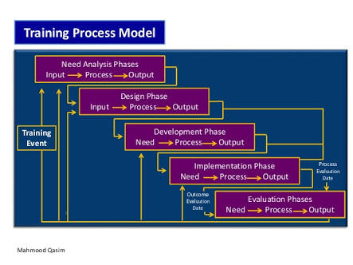
Training Processes Model

Slide 3
INPUT
PROCESS
OUTPUT
Instructional Material
Determine Factors that Facilitate Learning & Transfer
Instructional Equipment
Instructional Strategy
Trainee & Trainer Manuals
Alternative Instructional Methods
Development Phase
Facilities

Slide 4
Instructional Methods

Slide 5
Metode Training
(Blanchard & Thacker)
Lecture & Lecture/ Discussion
Computer-Based Training (CBT)
On-The-Job Training (OJT)
Games & Simulations

Slide 6
LECTURE
Lecture dirancang untuk transfer informasi, hal ini dapat diterapkan ketika tujuan atau sasaran knowledge & attitudinal telah ditetapkan.
Harus memfasilitasi komunikasi 2 arah→ melalui diskusi dan questioning.
QUESTIONING
Close-Ended vs Open-Ended
Overhead vs Direct Question
Relay vs Reverse Question

Slide 7
Encouraging Trainee to Respond
Do not rush to fill the silence.
Ask them to write out an answer.
Ice-breaker
1. Listening carefully to what is said
LISTENING- Active Listening
(Carl Rogers)
2. Summarizing in our mind what was said
3. Feeding this summary back to individual

Slide 8
Techniques for Maintaining Interest
Effective questioning & listening
Move around while talking
Use nonverbal communication
Get rid of dysfluencies
Provide Variety

Slide 9
Experiential Learning Model
Experience (the exercise/ game)
Lecturrete (provide information)
Processing (analysis of experience & information)
Generalizability (relevancy to other situations)
Practice (try it out)

Slide 10
COMPUTER-BASED TRAINING (CBT)
CBT sangat efektif untuk declarative knowledge.
Trainee dapat menyelesaikan training sesuai dengan kapasitasnya (own pace-own time) dan dari berbagai lokasi/ tidak harus hadir di ruangan training khusus.
CBT can handle knowledge-based training, while classroom training and OJT can deal with the hands on practice.
Dalan program CBT ada tiga hal yang harus dipertimbangkan (1) Self-pacing membuat trainee dapat memilih topik yang ingin dipelajari dengan tingkat kesulitan dan metode instruksi yang disesuaikan dengan keinginan sendiri; (2) Level of interactivity mengacu pada kemampuan program dalam merespon pertanyaan trainee; (3) The sophistication of the multimedia yaitu hubungan antara porsi audio dan visual dalam program training.

Slide 11
GAMES AND SIMULATIONS
EQUIPMENT SIMULATORS
Jika technical skills dalam mengoperasikan atau menjalankan suatu peralatan menjadi fokus training.
Untuk pekerjaan dimana error merupakan hal yang fatal terjadi.
BUSINESS GAMES
Fokus pada cognitive skills
Intercompany & Intracompany Business Games→ with & without competition
IN-BASKET
Fokus pada cognitive skills
Jika learning objectives nya fokus pada prioritizing, organizing & planning, & decision making.
CASE STUDY
Fokus pada cognitive skills
Trainee membaca kasus dan punya cukup waktu untuk mengembangkan jawaban dari kasus tsb
Harus memasukkan real situations.
Harus mencari yang relevan dan fokus pada satu bidang
Dibatasi waktu.
Trainer memfasilitasi diskusi.
Terutama pada problem solving skill.
ROLE PLAY/ BEHAVIOR MODELING
Goal dari training adalah interpersonal skills
Feedback menjadi komponen penting
Pada behavior modeling membutuhkan video.

Slide 12
ON-THE-JOB TRAINING
Job Instruction Training (JIT): 4 steps prepare-present-try out-follow up.
Apprenticeship membagi kegiatan menjadi classroom training dan workplace.
Coaching dimana supervisor menjalin hubungan dengan bawahan; supervisor secara berkelanjutan menganalisa kinerja bawahan, menyediakan iklim yang suportif, dan memotivasi bawahan untuk terus maju.
Mentoring biasanya dilakukan di level yang lebih tinggi dalam organisasi. Misal: senior manager menjadi mentor bagi junior manager.

Slide 13
Facilities
FURNITURE SET UP
THE TRAINING ROOM
OFF-SITE TRAINING FACILITIES

Slide 14
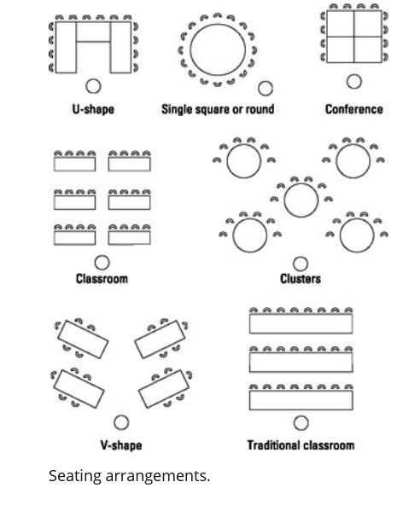
Room Arrangement

Slide 15
The trainer
Trainer credibility (first impression & experience)
Trainer KSA’s needed
KNOWLEDGE
Subject matter
Organization
SKILSS
Interpersonal communication skills
Verbal skills (ability to explain clearly): active listening, questioning, providing feedback
ATTITUDES
Commitment to organization
High-level of self-efficacy
Adult learning process
Instructional methods
Platform skills (ability to speak with inflection, gesture appropriately, and maintain eye contact)
Organization skills (ability to present information in logical order and stay on point)
Commitment to helping others

Slide 16
Integrated
Instructional Strategy

Slide 17
FACILITIES, MATERIAL, & EQUIPMENT, TRAINERS
METHOD OF INSTRUCTIONS
CONTENT: LEARNING POINTS

Slide 18
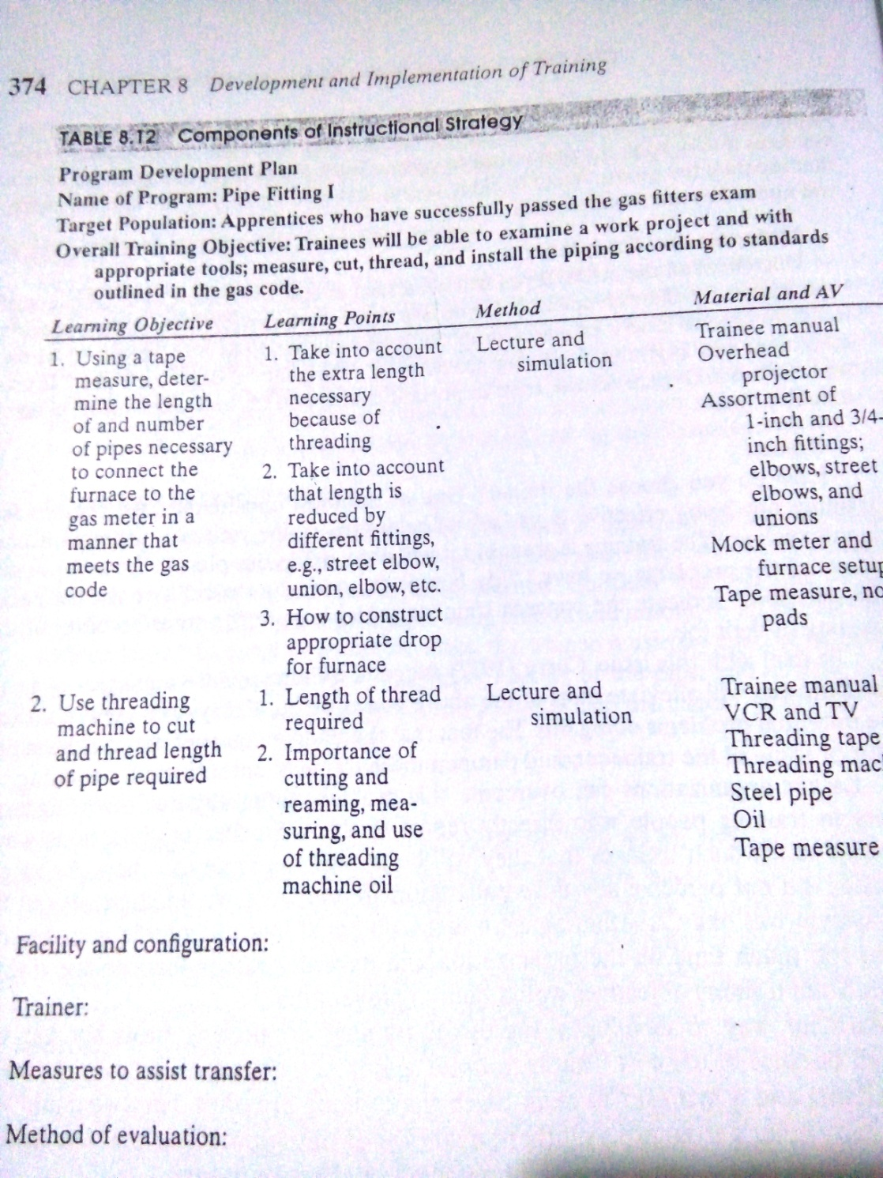
The Strategy

Slide 19
Implementation Phase of the Training Model
Instructional Material
Instructional Equipment
Dry Run
Pilot Program
Training Implementation
Trainee & Trainer Manuals
Evaluation Implementation & Assessment of Utility
Facilities
INPUT
PROCESS
OUTPUT

Slide 20
DISKUSI
Buat rundown dan materi ppt yang akan dipresentasikan dalam training kelompok.
Consult anything relate your training project with lecturer during this class.

