Slide 1

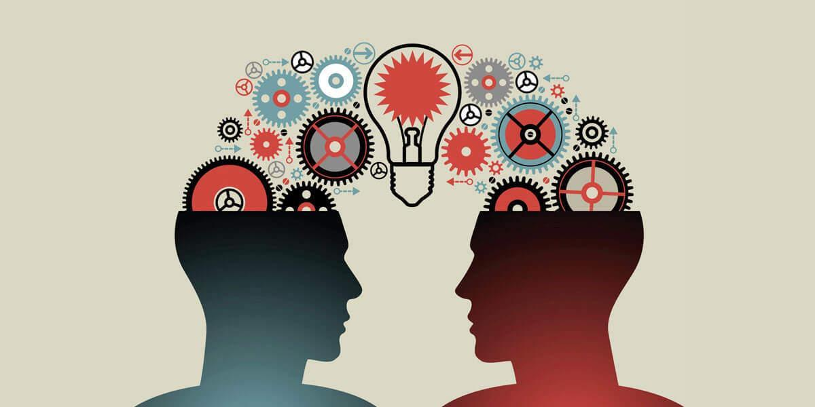

Behavioral Theories of Learning
Dinda Permatasari Harahap
Faculty of Psychology Universitas Medan Area
dinda@staff.uma.ac.id

Slide 2

Learning Materials
What’s Learning?
What Behavioral Learning Theories Have Evolved?
What Are Some Priciples of Behavioral Learning
How was Social Learning Theory Contributed to Our Understanding of Human Learning?

Slide 3


Learning
Learning is usually defined as a change in an individual caused by experience

Slide 4


What Behavioral Learning Theories Have Evolved?
Pavlov : Classical Conditioning
Thorndike : The Law of Effect
Skinner : Operant Conditioning

Slide 5
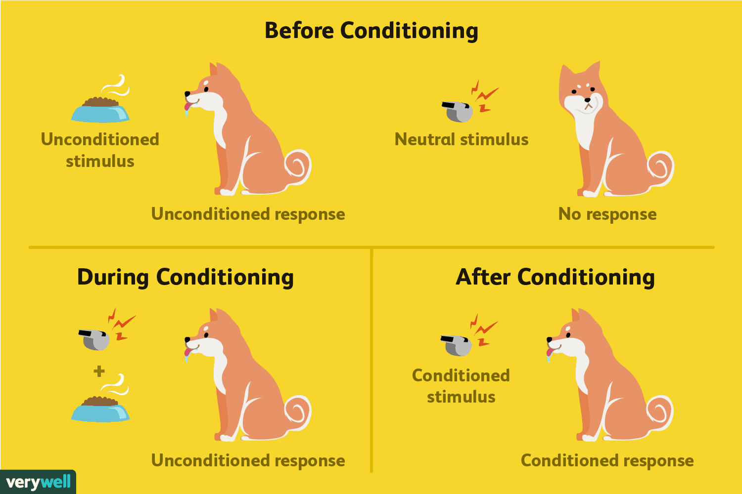

Pavlov : Classical Conditioning

Slide 6

In classical conditioning, a neutral stimulus (such as a bell) that at first prompts no response becomes paired with an unconditioned stimulus (such as meat) and gains the power of that stimulus to cause a response (such as salivation).

Slide 7
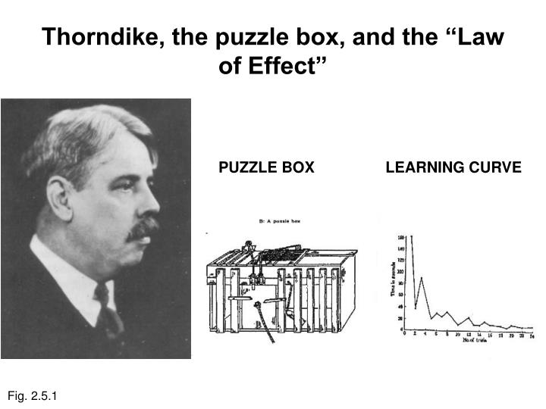
Thorndike : Law of Effect

Slide 8

Behaviors followed by favorable consequences become more likely, and behaviors followed by unfavorable consequences become less likely

Slide 9
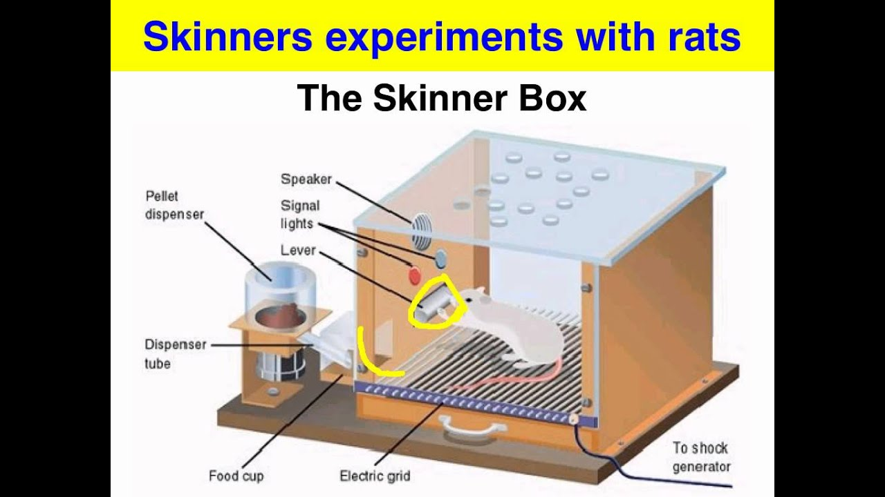
Skinner : Operant Conditioning

Slide 10
An individual makes an association between a particular behaviour and a consequence

Slide 11

What Are Some Principles of Behavioral Learning?
The Role of Consequences
Reinforcers
Intrinsic and Extrinsic Reinforcers
Punishers
Immediacy of Consequences
Shaping
Extinction
Schedules of Reinforcement
Maintenance
The Role of Antececents

Slide 12
The Role of Consequences
The most important principle of behavioral learning theories is that
behavior changes according to its immedate consequences
Consequences
strengthen behavior; unpleasant consequences weaken it
Consequences are called reinforcers; unpleasant consequences are called punishers

Slide 13
Reinforcers
Any consequences that strenghthens (increases the frequency of) a behavior
The effectiveness of the reinforce must be demonstrate
Consequences are called reinforcers; unpleasant consequences are called

Slide 14
Primary and Secondary Reinforcers
Primary
Satisfy basic human needs. Some
examples are food, water, security, warmth, and sex
Reinforcers that acquire their value by being associated with primary reinforcers or other well-established secondary reinforcers
Secondary

Slide 15
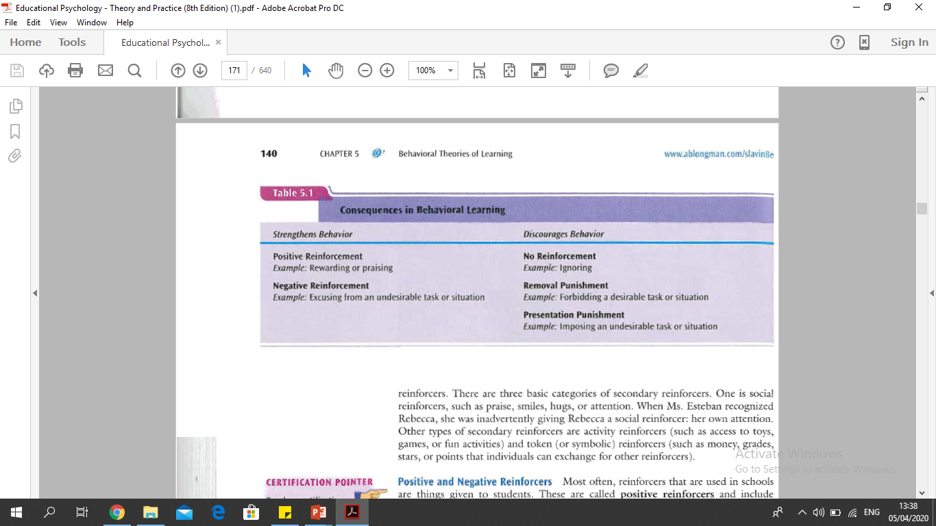

Slide 16
Positive and Negative Reinforcers
Positive
Reinforcers that are used in schools are things given to students.
Ex : praise, grades, and stars
Reinforcers that are escapes from unpleasant situations
Negative

Slide 17
The Premack Principle
Sometimes called "Grandma's Rule" from the age-old statement
"Eat your vegetables, and then you may play."
As soon as you finish your work, you may go outside

Slide 18
Intrinsic and Extrinsic Reinforcers
Behaviors that a person enjoys engaging in for their own sake, without any other reward.
Intrinsic
Praise or rewards given to motivate people to engage in behavior that they might not engage in without thein.
Extrinsic

Slide 19


PUNISHER
Unpleasant consequences
used to weaken behavior..

Slide 20
PUNISHER
Presentation Punishment
An aversive stimulus following a behavior, to decrease the chances that the behavior will occur again.
Aversive Stimulus
An unpleasant consequence that a person tries to avoid or escape.

Slide 21
PUNISHER
Removal Punishment
Withdrawal of a pleasant consequence that is reinforcing a behavior, designed to decrease the chances that the behavior will recur.
Time Out
Procedure of removing a student fiom a situation in which misbehavior was being reinforced.

Slide 22

Immediacy of Consequences
it makes clear the connection
between behavior and consequence
PURPOSES
it increases the informational value
of the feedback

Slide 23

Shaping
The teaching of a new skIll
or behavior by means of
reinforcement for small
steps toward .
Extintion
The weakening and eventual
elimination of a learned
behavior as reinforcement is
withdrawn.

Slide 24
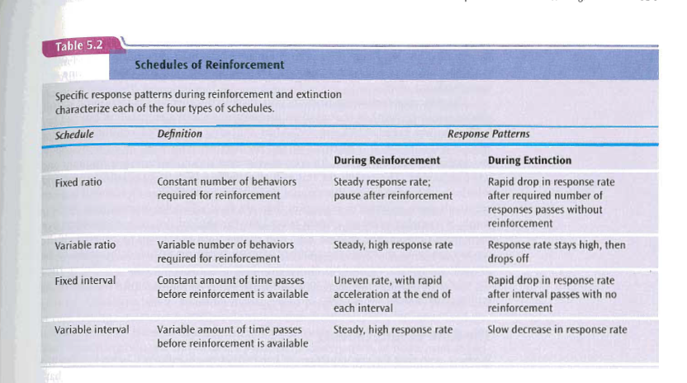

Slide 25
How was Social Learning Theory Contributed to Our Understanding of Human Learning?
Bandura-Modeling and Observational Learning
Meichenbaums Model of Self Regulated Learning
Strenghts and Limitations of Behavioral Theories

Slide 26

Bandura
Modeling & Observational Learning
Attention
Retention
Reproduction
Motivation
Observational Learning

Slide 27
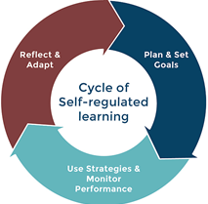
Meichenbaums
Model of Self Regulated Learning

Slide 28
Strenghts and Limitations of Behavioral Learning Theories
LET’S DISCUSS

Slide 29
THANK YOU

