Slide 1

SOME TYPOLOGY IN PERSONAL PSYCHOLOGY

Slide 2
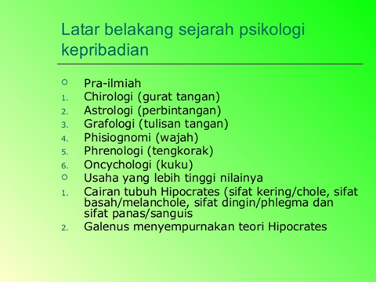

Slide 3
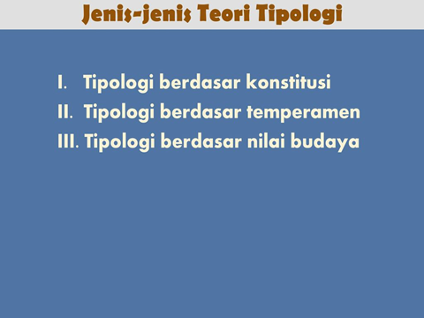

Slide 4
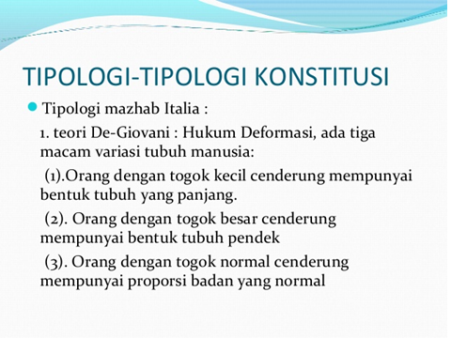

Slide 5
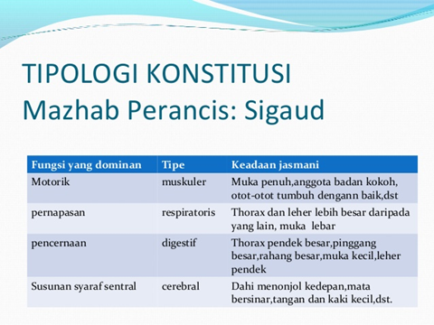

Slide 6
