Slide 1

STAGE OF DEVELOPMENT ACCORDING TO SIGMUND FREUD

Slide 2
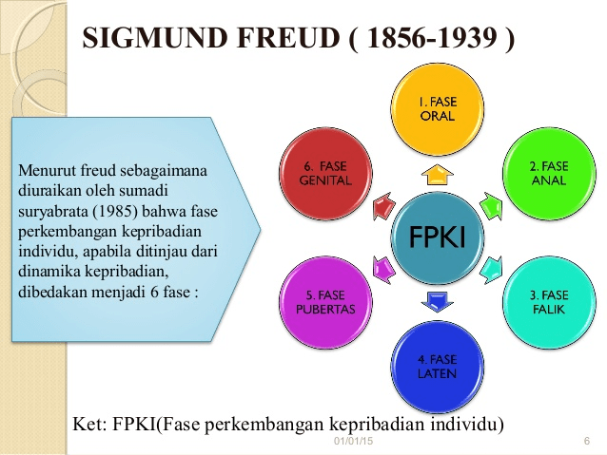

Slide 3
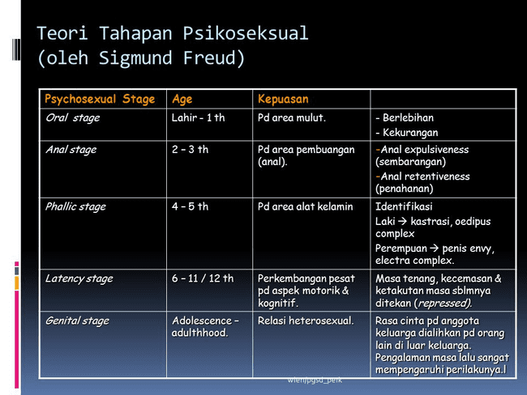

Slide 4
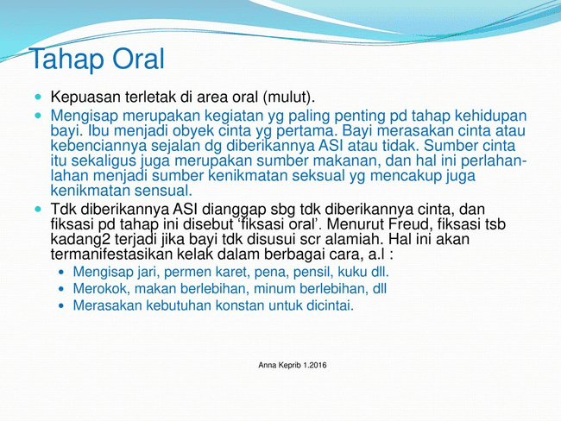

Slide 5
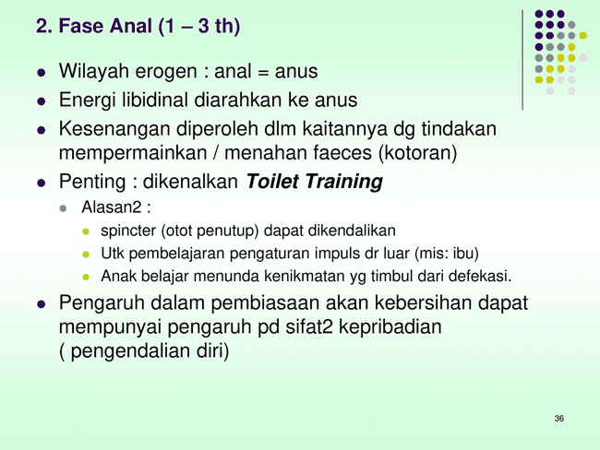

Slide 6
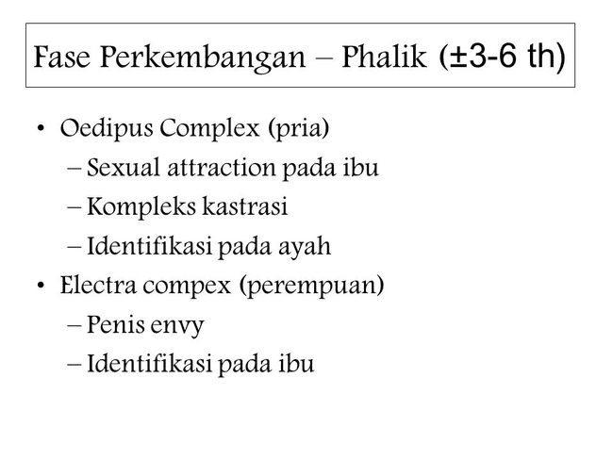

Slide 7
