Slide 1
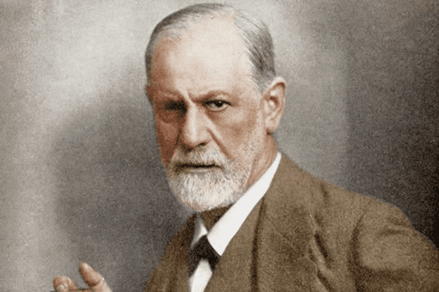
THEORY OF PSYCHOANALISM SIGMUND FREUD

Slide 2
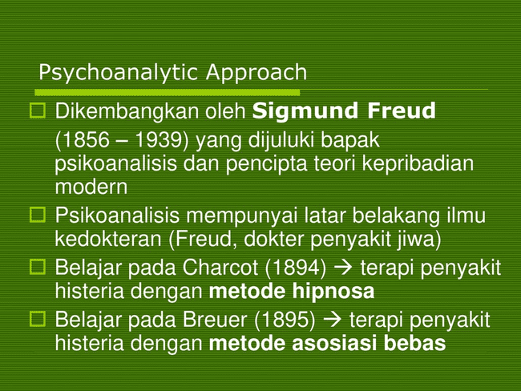

Slide 3
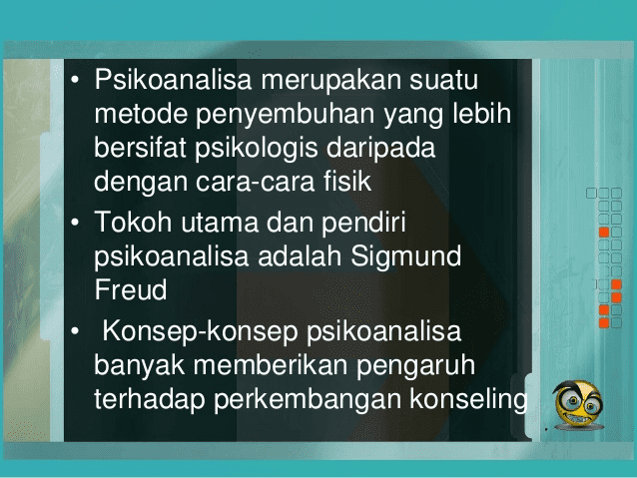

Slide 4


Slide 5
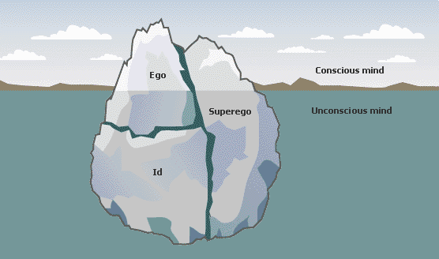
FENOMENA ICEBERG

Slide 6
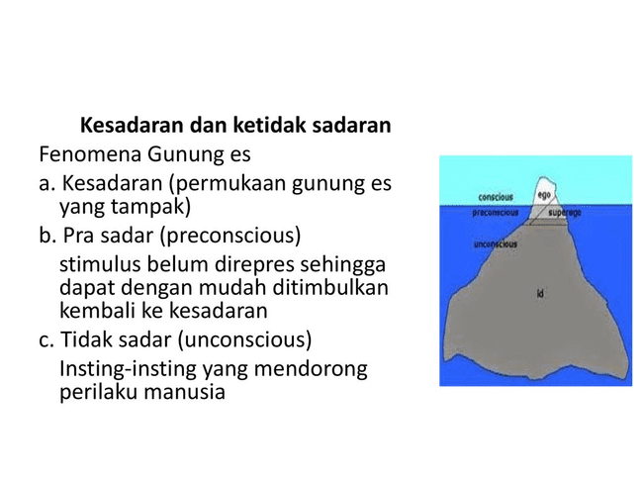

Slide 7
