Slide 1
Introduction:
The Nature of Leadership
Cut Sarah, M. Psi., Psikolog

Slide 2
Learning Objectives
Memahami definisi kepemimpinan
Memahami perbedaan antara kepemimpinan dan manajemen; Leader VS Manager
Memahami kompleksitas mengukur efektivitas kepemimpinan
Memahami indikator-indikator efektivitas kepemimpinan
Memahami aspek-aspek kepemimpinan yang diteliti selama 50 tahun terakhir
Memahami kepemimpinan dalam konteks individual, kelompok, dan proses organisasi.

Slide 3
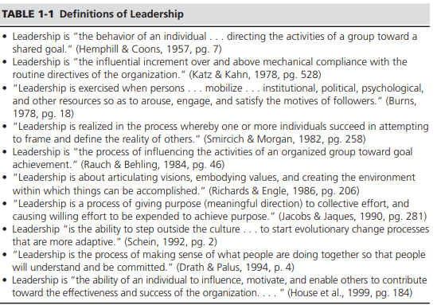
Definisi Leadership (Kepemimpinan)
Sering mixed up dengan istilah-istilah power, authorithy, management, administration, control, & supervision.

Slide 4
Kepemimpinan meliputi proses menggunakan pengaruhnya terhadap orang lain untuk membimbing, mengatur, dan memfasilitasi aktivitas dan hubungan-hubungan dalam kelompok atau organisasi.
Kepemimpinan adalah fenomena penting bagi efektivitas suatu organisasi.

Slide 5
Specialized Role or
Shared Influence Process?
Pemimpin as specialized role dianggap bahwa setiap anggota dari suatu kelompok pasti memiliki perannya masing-masing, termasuk peran pemimpin yang memiliki tanggung jawab dan fungsi-fungsi yang tidak bisa dibagi secara luas tanpa mengorbankan efektivitas dari kelompok → Leader-Followers
Pemimpin as shared influence process dianggap sebagai proses yang terjadi secara alami dalam sistem sosial yang dibagi bersama antar anggotanya.
Definisi yang lebih sesuai untuk mempejari konstruk kepemimpinan
Notes:
Researchers who view leadership as a shared, diffuse process, are likely to pay more attention to the complex influence processes that occur among members, the context and conditions that determine when and how they occur, and the consequences for the group or organization.

Slide 6
Types of Influence Process
Enthusiastic commitment by followers
Indifferent compliance or reluctant obediance
use rewards & punishments to manipulate/ coerce followers
Unethical use of power

Slide 7
Direct VS Indirect Leadership
Direct leadership meliputi usaha mempengaruhi bawahannya ketika berinteraksi dengan mereka atau menggunakan media komunikasi untuk mengirimkan pesan pada mereka. Contoh: mengirim memo, email, menyelenggarakan meeting, dll.
Indirect leadership menunjukkan usaha mempengaruhi orang-orang di level bawah dalam organisasi yang tidak berinteraksi secara langsung dengan pemimpin. Contoh: CEO menampilkan diri sebagai contoh yang baik dalam menegakkan kode etik dan bersikap supportif dapat mempengaruhi level bawah organisasi.
Notes:
Another form of indirect leadership involves influence over formal programs, management systems, and structural forms (Hunt, 1991; Lord & Mahar, 1991; Yukl & Lepsinger, 2004). Many large organizations have programs or management systems intended to influence the attitudes, skills, behavior, and performance of employees. Examples include programs for recruitment, selection, and promotion of employees. A CEO can select only people with similar traits in order to develop a strong culture of shared values (Giberson, Resick, & Dickson, 2005).

Slide 8
Leadership vs Management
“…a person can be a leader without being a manager (e.g., an informal leader), and a person can be a manager without leading. Indeed, some people with the job title “manager” do not have any subordinates (e.g., a manager of financial accounts). “
Managers are concerned about how things get done, and they try to get people to perform better. Leaders are concerned with what things mean to people, and they try to get people to agree about the most important things to be done.
Bennis and Nanus (1985, p. 21) proposed that “managers are people who do things right, and leaders are people who do the right thing.
Kotter (1990) proposed that managing seeks to produce predictability and order, whereas leading seeks to produce organizational change. Both roles are necessary, but problems can occur if an appropriate balance is not maintained. Too much emphasis on the managing role can discourage risk taking and create a bureaucracy without a clear purpose. Too much emphasis on the leadership role can disrupt order and create change that is impractical→ depends in part on the situation.

Slide 9
Conclusion from definition of leadership (Yukl, 2010):
Leadership is the process of influencing others to understand and agree about what needs to be done and how to do it, and the process of facilitating individual and collective efforts to accomplish shared objectives.
Notes:
In this book, leadership is treated as both a specialized role and a social influence process. More than one individual can perform the role (i.e., leadership can be shared or distributed), but some role differentiation is assumed to occur in any group or organization. Both rational and emotional processes are viewed as essential aspects of leadership. No assumptions are made about the actual outcome of the influence processes, because the evaluation of outcomes is difficult and subjective.

Slide 10
Indikator Efektivitas Kepemimpinan
(1) Sejauh mana kinerja tim dalam unit organisasi didorong dan pencapaian tujuan difasilitasi.
Objective Measures of Performance
Sales
Net profits
Subjective Measures of Performance
Ratings obtained from the leader’s superior, peers, or subirdinated
Profits margin
Market share
ROI
Productivity, etc

Slide 11
Indikator Efektivitas Kepemimpinan
(2) Sikap & persepsi follower terhadap leader. Dapat diukur dengan kuesioner atau wawancara.
(3) Efektivitas pemimpin juga dapat diukur berdasarkan kontribusinya terhadap kualitas proses kelompok yang dipersepsikan oleh pihak luar/ observer. (Does the leader enhance group cohesiveness, member cooperation, member commitment, and member confidence that the group can achieve its objectives? Does the leader enhance problem solving and decision making by the group, and help to resolve disagreements and conflicts in a constructive way? Does the leader contribute to the efficiency of role specialization, the organization of activities, the accumulation of resources, and the readiness of the group to deal with change and crises?)
(4) Sejauh mana orang tersebut memiliki karir yang sukses sebagai pemimpin. (Is the person promoted rapidly to positions of higher authority? Does the person serve a full term in a leadership position, or is he or she removed or forced to resign? For elected positions in organizations, is a leader who seeks reelection successful?)
Notes:
How well does the leader satisfy the needs and expectations of followers? Do they like, respect, and admire the leader? Do they trust the leader and perceive him or her to have high integrity? Are they strongly committed to carrying out the leader’s requests, or will they resist, ignore, or subvert them? Does the leader improve the quality of work life, build the self-confidence of followers, increase their skills, and contribute to their psychological growth and development? Follower attitudes, perceptions, and beliefs also provide an indirect indicator of dissatisfaction and hostility toward the leader. Examples of such indicators include absenteeism, voluntary turnover, grievances, complaints to higher management, requests for transfer, work slowdowns, and deliberate sabotage of equipment and facilities.

Slide 12
Overview of Major Research Approaches
3 tipe variabel yang relevan untuk memahami efektivitas kepemimpinan:
Karakteristik LEADER
Traits (motives, personality, values)
Skills & expertise
KARAKTERISTIK FOLLOWERS
Traits (needs, values, self concept)
Confidence & optimism
KARAKTERISTIK SITUATION
Type of organizational unit
Position, power, & authority of leader
Confidence & optimism
Behavior
Integrity
Influence tactics
Attribution about followers
Skills & expertise
Attribution about leader
Trust in leader
Task commitment & effort
Satisfaction with job & leader
Size of unit
Task structure & complexity
Task independence
Organizational culture
Environmental uncertainty
External dependencies
National cultural value

Slide 13
1. THE TRAIT APPROACH
5. THE INTEGRATIVE APPROACH
2. THE BEHAVIOR APPROACH
Theories & Empirical Research about Leadership
4. THE SITUATIONAL APPROAC H
3. THE POWER-INFLUENCE APPROACH

Slide 14
Levels of Conceptualization for Leadership Process
ORGANIZATION
GROUP
DYADIC
INDIVIDUAL

Slide 15
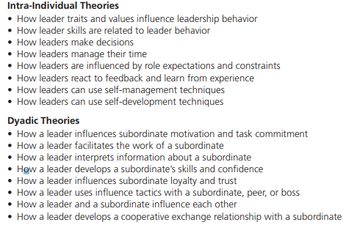
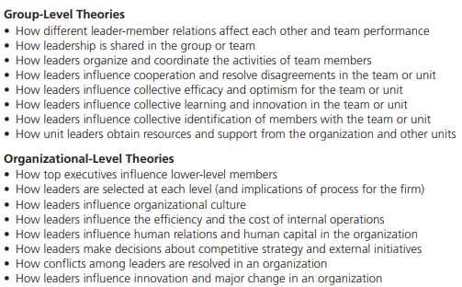
Research Questions at Different Levels of Conceptualization

Slide 16
Other Bases for Comparing Leadership Theories
Leader-Centered vs Follower-Centered Theory
Universal vs Contingency Theory
Descriptive vs Prescriptive Theory

Slide 17
GROUP DISCUSSION
What are some similarities and differences in the way leadership has been defined?
Does it really matter how you define leadership? Explain and defend the position you take on this question.
What are the arguments for and against making a distinction between leaders and managers?
Why is it so difficult to measure leadership effectiveness?
What criteria have been used to evaluate leadership effectiveness? Are some criteria more useful than others?
What are the trait, behavior, and power-influence approaches? What unique insights does each approach provide about effective leadership?
Why does it matter whether leadership is described as an intra-individual, dyadic, group, or organizational process? Which level of analysis is emphasized in most leadership theories and research?
Compare universal and contingency theories. Is it possible to have a theory with both universal and contingent aspects?

Slide 18
Tugas Utama Psikologi Kepemimpinan
Tugas Individual: Review Jurnal terkait Psikologi kepemimpinan.
Tugas Kelompok:
-Diskusi mingguan
-Presentasi Studi Kasus by Chapter
-Analisis Tokoh
Deadline: (Tugas Individual pengumpulan bebas maksimal 2 minggu sebelum UAS)
(Tugas Kelompok: Presentasi studi kasus (sesuai pembagian kelompok); Analisis Tokoh (Presentasi di dua pertemuan akhir sebelum UAS).
NB: Tidak ada perbaikan nilai, nilai setelah UAS fixed tidak dapat diganggu gugat.
Tugas tambahan (jika merasa perlu)→ Review Buku apapun dikaitkan dengan Psikologi Kepemimpinan.

Slide 19
KELOMPOK | BAGIAN PEMBAHASAN (SUMBER, YUKL 2010)
1 | Chapter 2 (The Nature of Managerial Work)
2 | Chapter 3 (Perspective on Effective Leadership Behavior)
3 | Chapter 4 (Participative Leadership, Delegation, & Empowerment)
4 | Chapter 5 (Dyadic Relations, Attributions, & Followership)
5 | Chapter 6 (Power & Influence)
6 | Chapter 7 (Managerial Traits & Skills)
7 | Chapter 8 (Early Contingency Theories of Effective Leadership)
8 | Chapter 9 (Charismatic & Transformasional Leadership)
9 | Chapter 10 (Leading Change in Organizations)
10 | Chapter 11 (Leadership in Teams & Decision Groups)

