Slide 1
Introduction to leadership psychology & managerial work
Rizty Desta Mahestri, M.Psi., Psikolog – Fakultas Psikologi Universitas Medan Area

Slide 2
What do you think about :

Slide 6
LEADERSHIP?

Slide 7
Definitions of Leadership
“No single, “correct” definition of leadership covers all situations; what matters is how useful the definition is for increasing our understanding of effective leadership”

Slide 8
Definitions of Leadership
Leadership is the process of influencing others to understand and agree about what needs to be done and how to do it, and the process of facilitating individual and collective efforts to accomplish shared objectives.
Yukl
2010

Slide 9
Definitions of Leadership
“Leadership has been defined in many different ways, but most definitions share the assumption that it involves an influence process concerned with facilitating the performance of a collective task”

Slide 10
Specialized Role or Shared Influence Process?
Specialized Role
Influence Process

Slide 11
Specialized Role or Shared Influence Process?
Specialized Role
Influence Process

Slide 12
Specialized Role
There’s LEADER
Other members are FOLLOWERS
It does not mean that a person cannot perform both roles at the same time

Slide 13
Specialized Role or Shared Influence Process?
Specialized Role
Influence Process

Slide 14
Share Influence Process
Influence process that occurs naturally within a social system and is difussed among the members
Any member may exhibit leadership at anytime
There’s NO clear distinction between leaders and followers

Slide 15
Type of influence Process
Enthusiastic Commitment
Reluctant Obedience / Indifferent Compliance

Slide 16
Purpose of Influence Attempts
“Acts of leadership often have multiple motives, and it is seldom possible to determine the extent to which they are selfless rather than selfish”

Slide 17
Influence Based on Reason or Emotion
Most of the leadership definition listed earlier emphasize rational, cognitive processes : achieving shared task objective
1980s : Few conceptions of leadership recognized the importance of emotions as a basis for influence
Leaders inspire followers to willingly sacrifice their selfish interests for a higher cause

Slide 18
Direct vs. Indirect Leadership
“Most theories about effective leadership focus on behaviors used to directly influence immediate subordinates, but a leader can also influence other people inside the organization”

Slide 19
Leadership vs. Management
A person can be a leader without being a manager
A person can be a manager without leading

Slide 20
Leadership vs. Management
LEADERSHIP | MANAGEMENT
Leaders VALUE flexibility, innovation, and adaptation ; care about people as well as economic outcomes. | Managers VALUE stability, order, and efficiency, and they are impersonal, risk adverse and focused on short-term result.
Leaders are CONCERNED with what things mean to people, and they try to get people agree about the most important things to be done. | Managers are CONCERNED about how things get done, and they try to get people to perform better.

Slide 21
Leadership vs. Management
“Kotter (1990) proposed that managing seeks to produce predictability and order, whereas leading seeks to produce organizational change.
Both roles are necessary, but problems can occur if an appropriate balance is not maintained”

Slide 22
Leadership vs. Management
“Success as a manager or administrator in modern organizations also involves leading”

Slide 23
Typical Activity Patterns in Managerial Work
Pace of work is HECTIC and unrelenting
Decision processes are disorderly and political
Most planning is informal and adaptive
Content of work is varied & fragmented
Many activities are reactive
Interactions often involve peers & outsiders and oral com

Slide 24
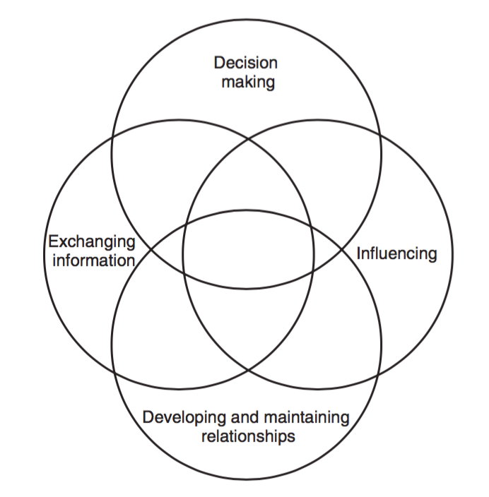
Four Primary Process in Managing

Slide 25
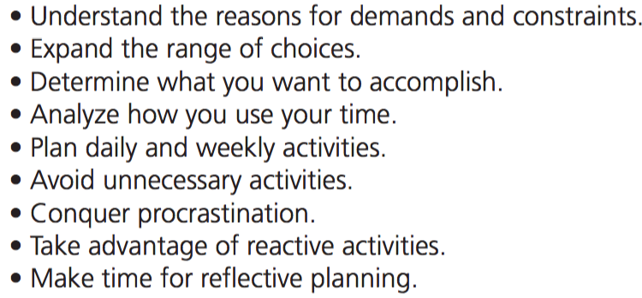
Guidelines for Performing Managerial Work : Managing Time

Slide 26
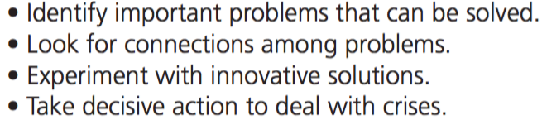
Guidelines for Performing Managerial Work : Problem Solving

Slide 27
Thank You

